Slide 1
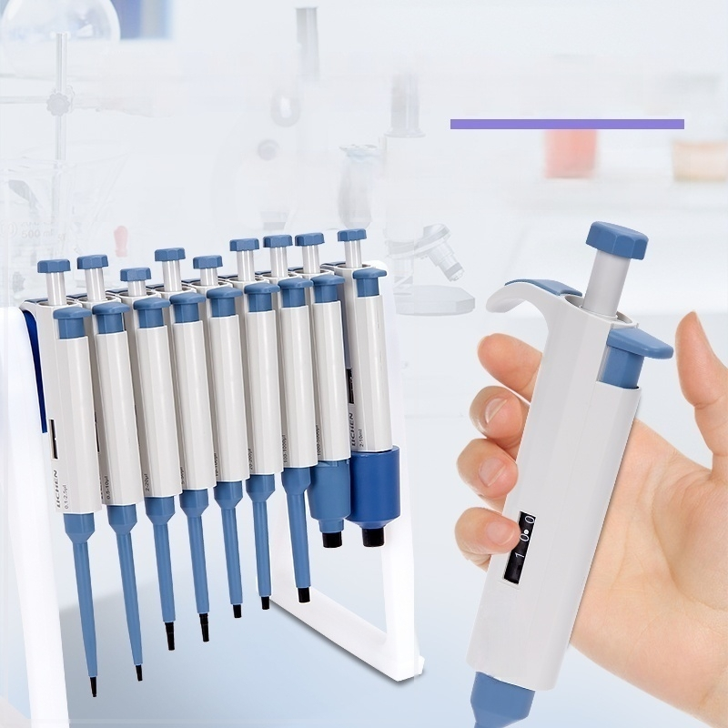
Handle hook design easy hanging
Lightweight and designed in line with human-machine
efficiency,comfortable hand feeling,light suction and
drainage operation force,to avoid repetitive muscle strain.
5 质
这

Slide 2
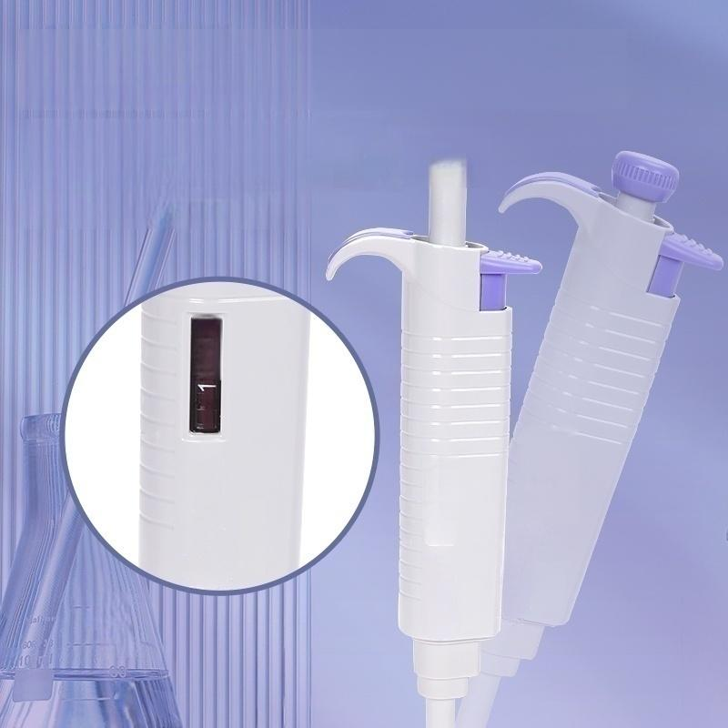


Digital window at a glance
Manual single channel adjustable, the number is clearly visible,
covering the full range of 0.1 uL-10ml set range at a glance.
00
0:0.L
0.5-10ul
100
APPROX
80
0.5-10l
20-200ul
0

Slide 3
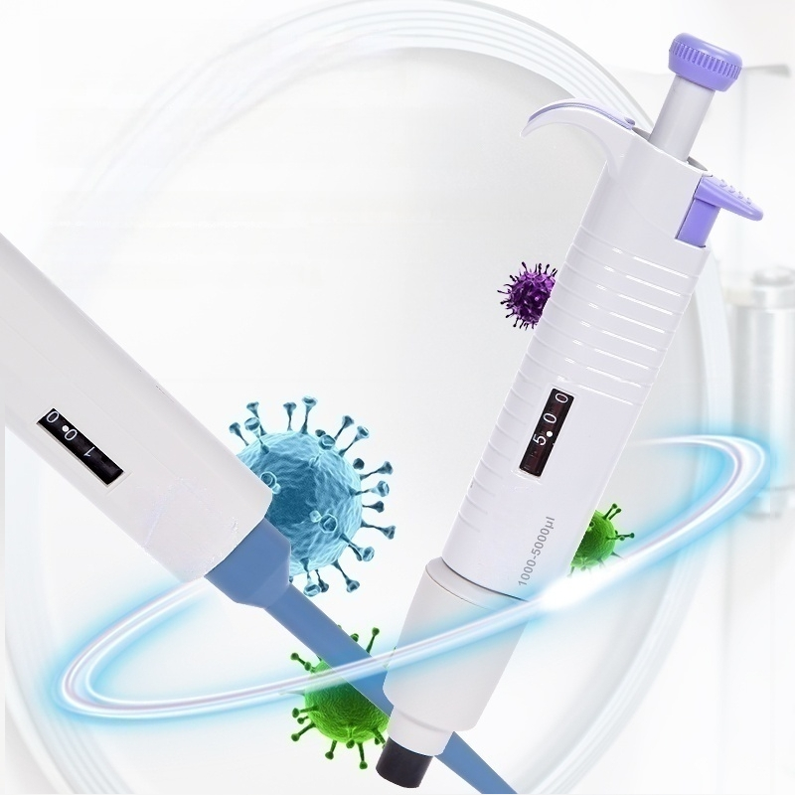
Single-channel
half-branch disinfection
Whole sterilized pipette
Blue is a half-branch disinfection pipette,and the second half can be disinfected at 121℃under high
temperature and high pressure.
The whole branch can be sterilized by
high temperature and high pressure,
Purple for the whole disinfection pipette,
Strong reusability and low maintenance cost

Slide 4
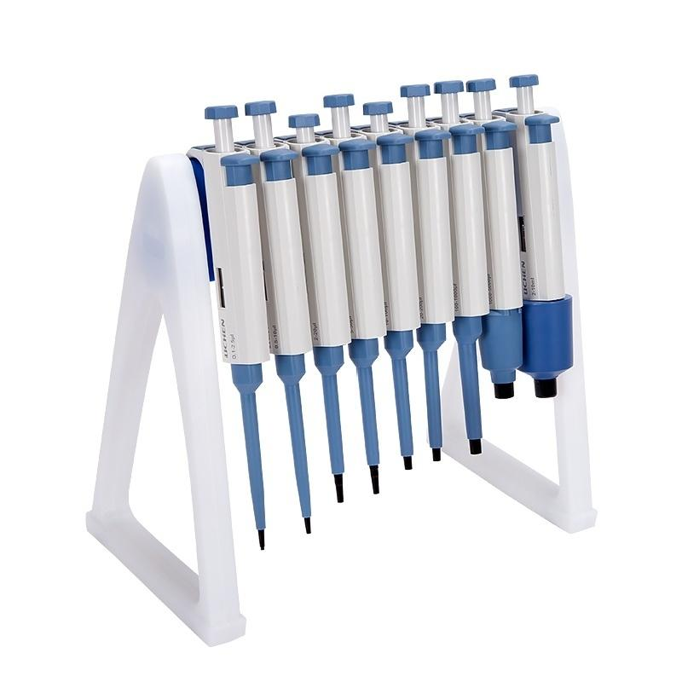

Slide 5
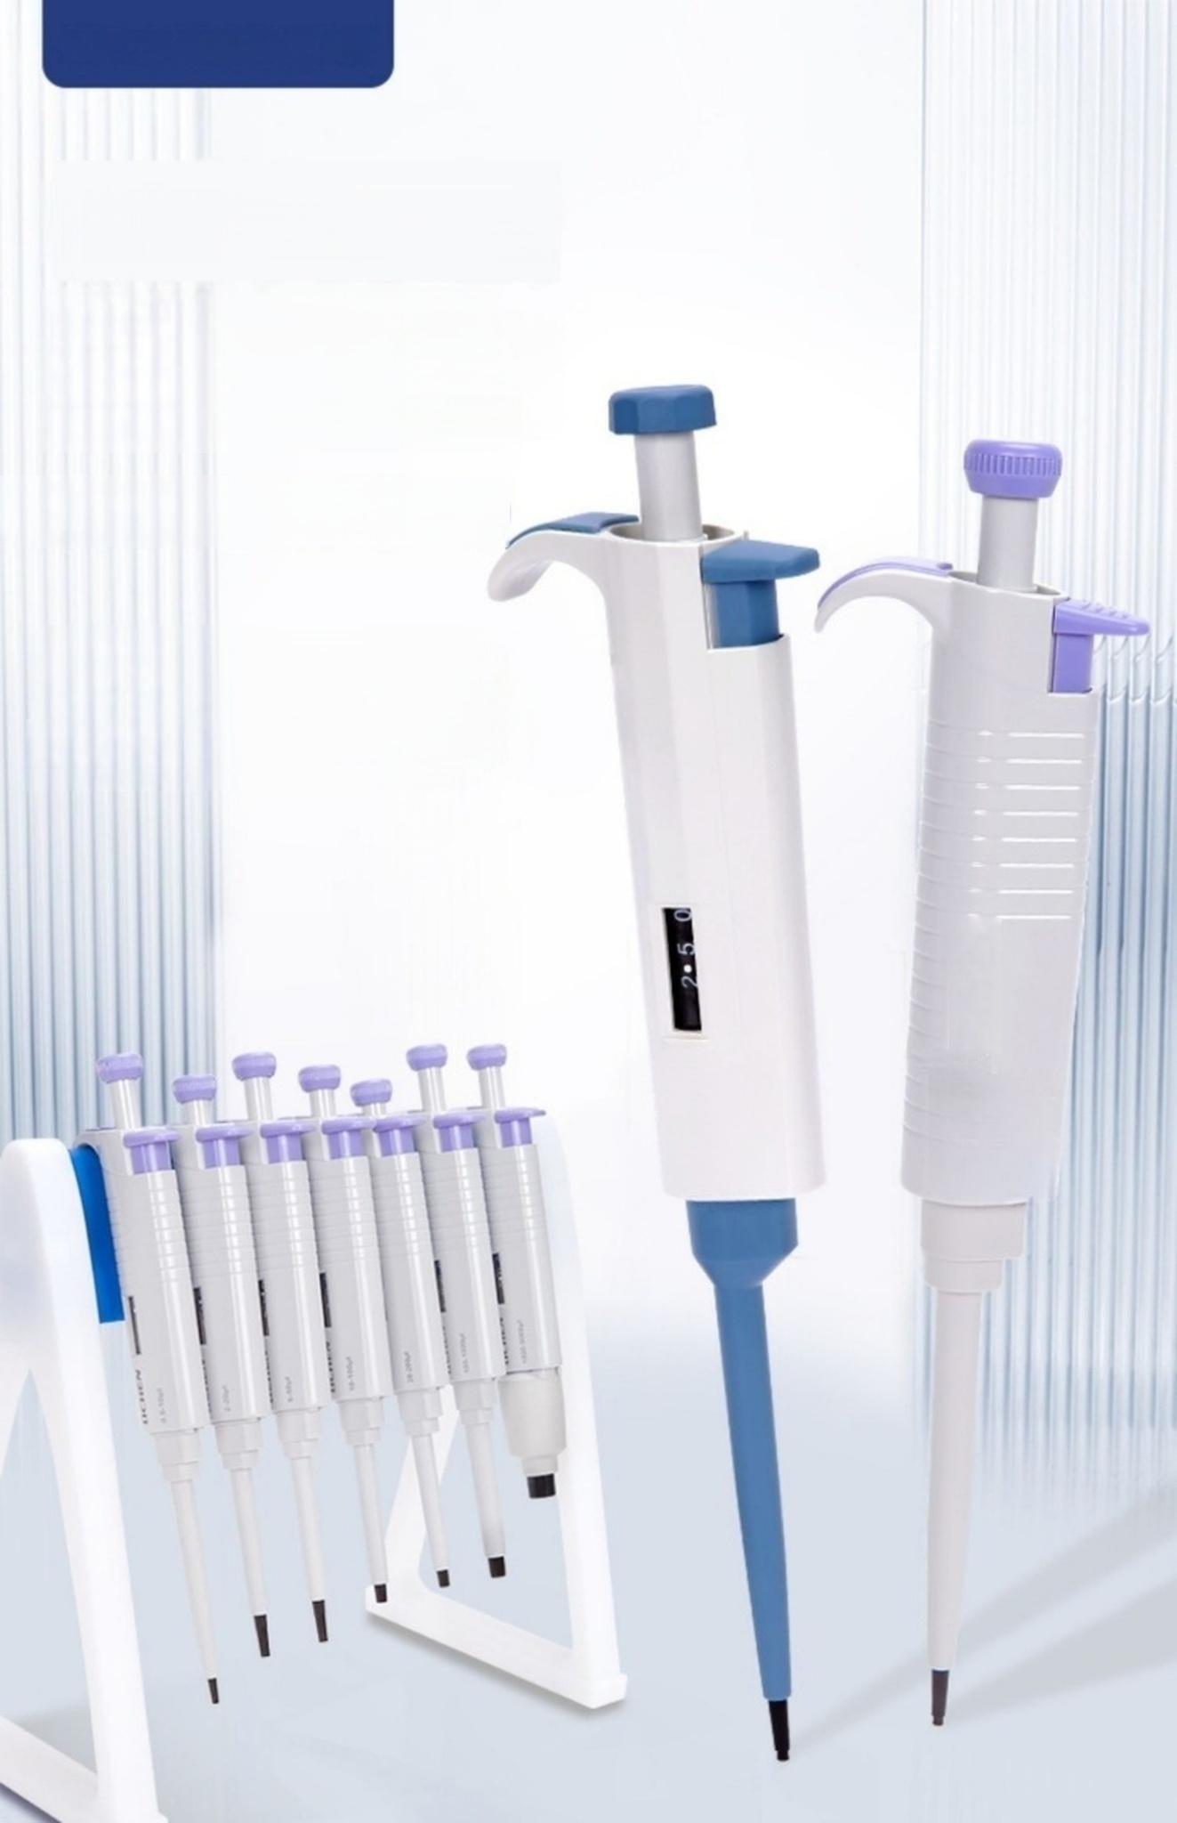

Sampling analysis
Lightweight
and Portable
Single Channel Adjustable Micropipette
///For liquid sampling
and transfer ///Multiple models 1 Wide range
2.00

Slide 6
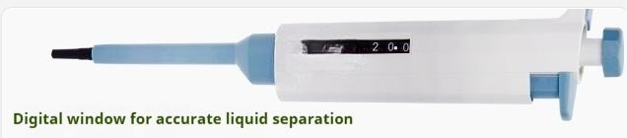
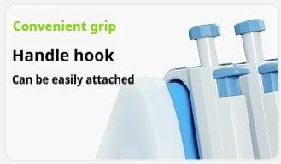
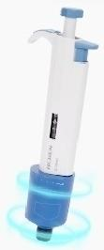
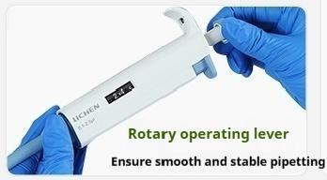
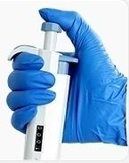
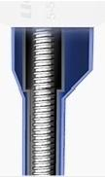
I Overview of Selling Points
Product Features
The set range is clear at a glance
Half-branch disinfection
Can be 121℃high temperature and high pressure disinfection
Comfortable Feel |  |  | High strength,fast rebound
Avoid | repetitive |  | High quality spring group
muscle | strain

Slide 7
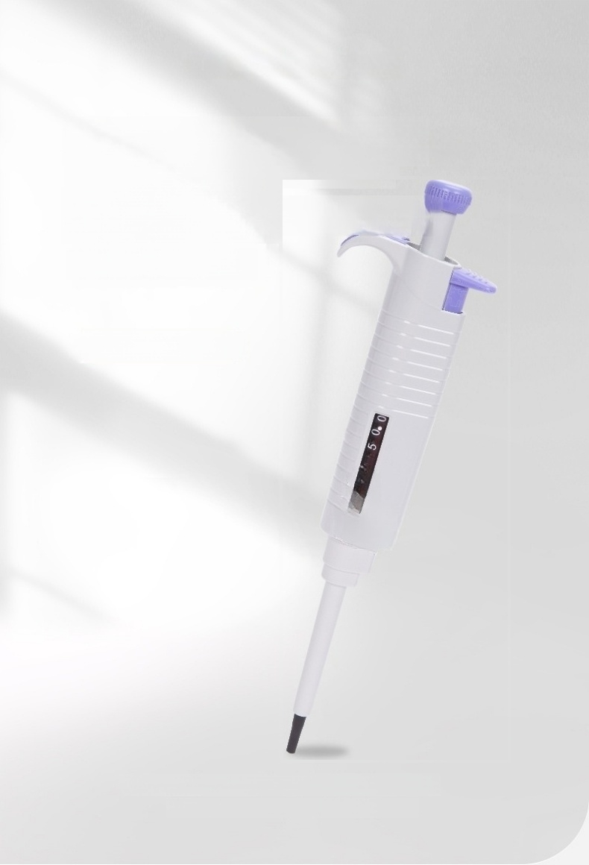
Accurate pipetting of the whole sterilized
single-channel pipette
Easy to operate
(Discovery-F Series)
Selection of a new generation of laboratories
The choice of new generation laboratories

Slide 8
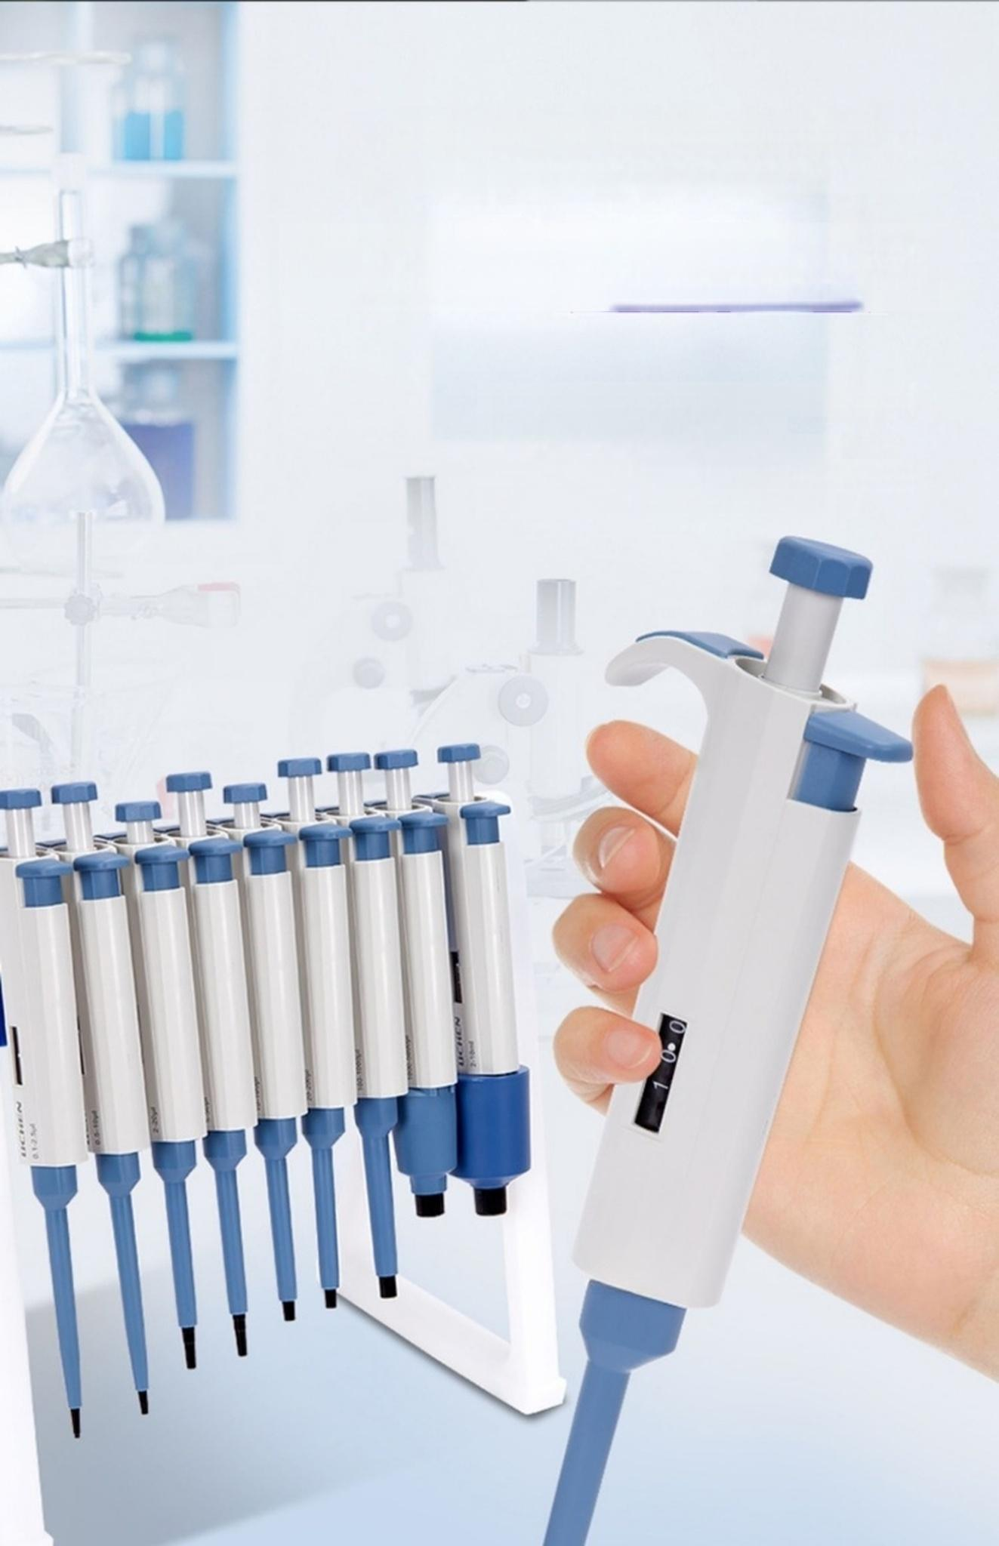
Handle hook design
Can be easily attached
Lightweight and designed in line with
human-computer efficacy,
comfortable hand feeling,light
avoiding repetitive muscle strain
suction and drainage operation force,

Slide 9
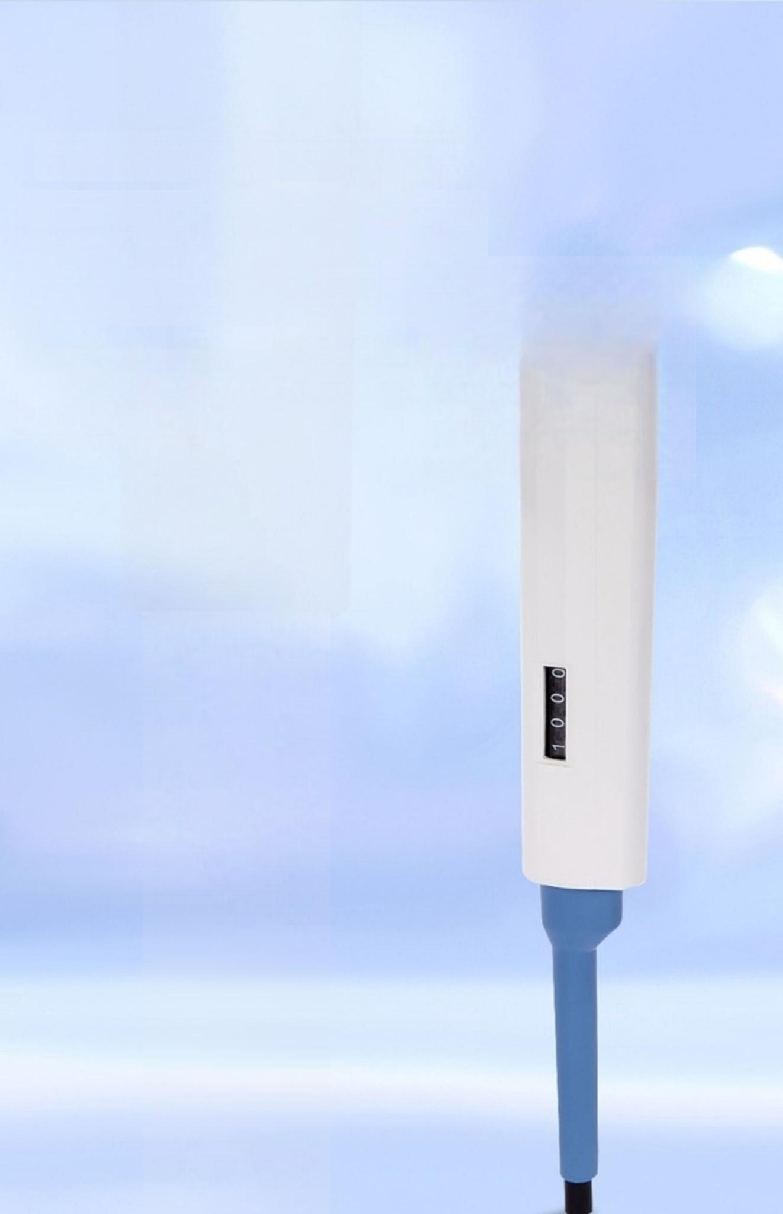
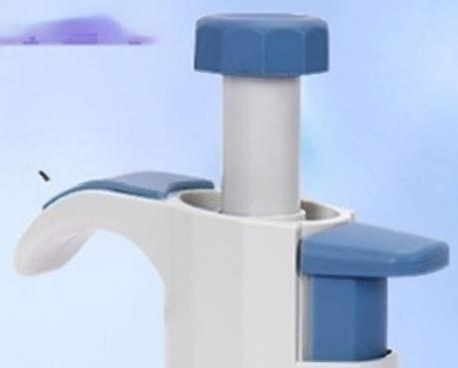
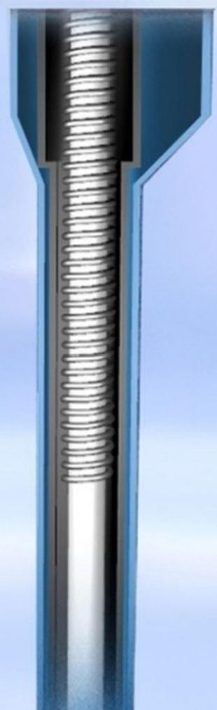
Piano wire spring group
High strength and good toughness
Piano wire spring group,high strength,
good toughness,fast rebound,no
deformation,to ensure good feel and
performance of the pipette

Slide 10
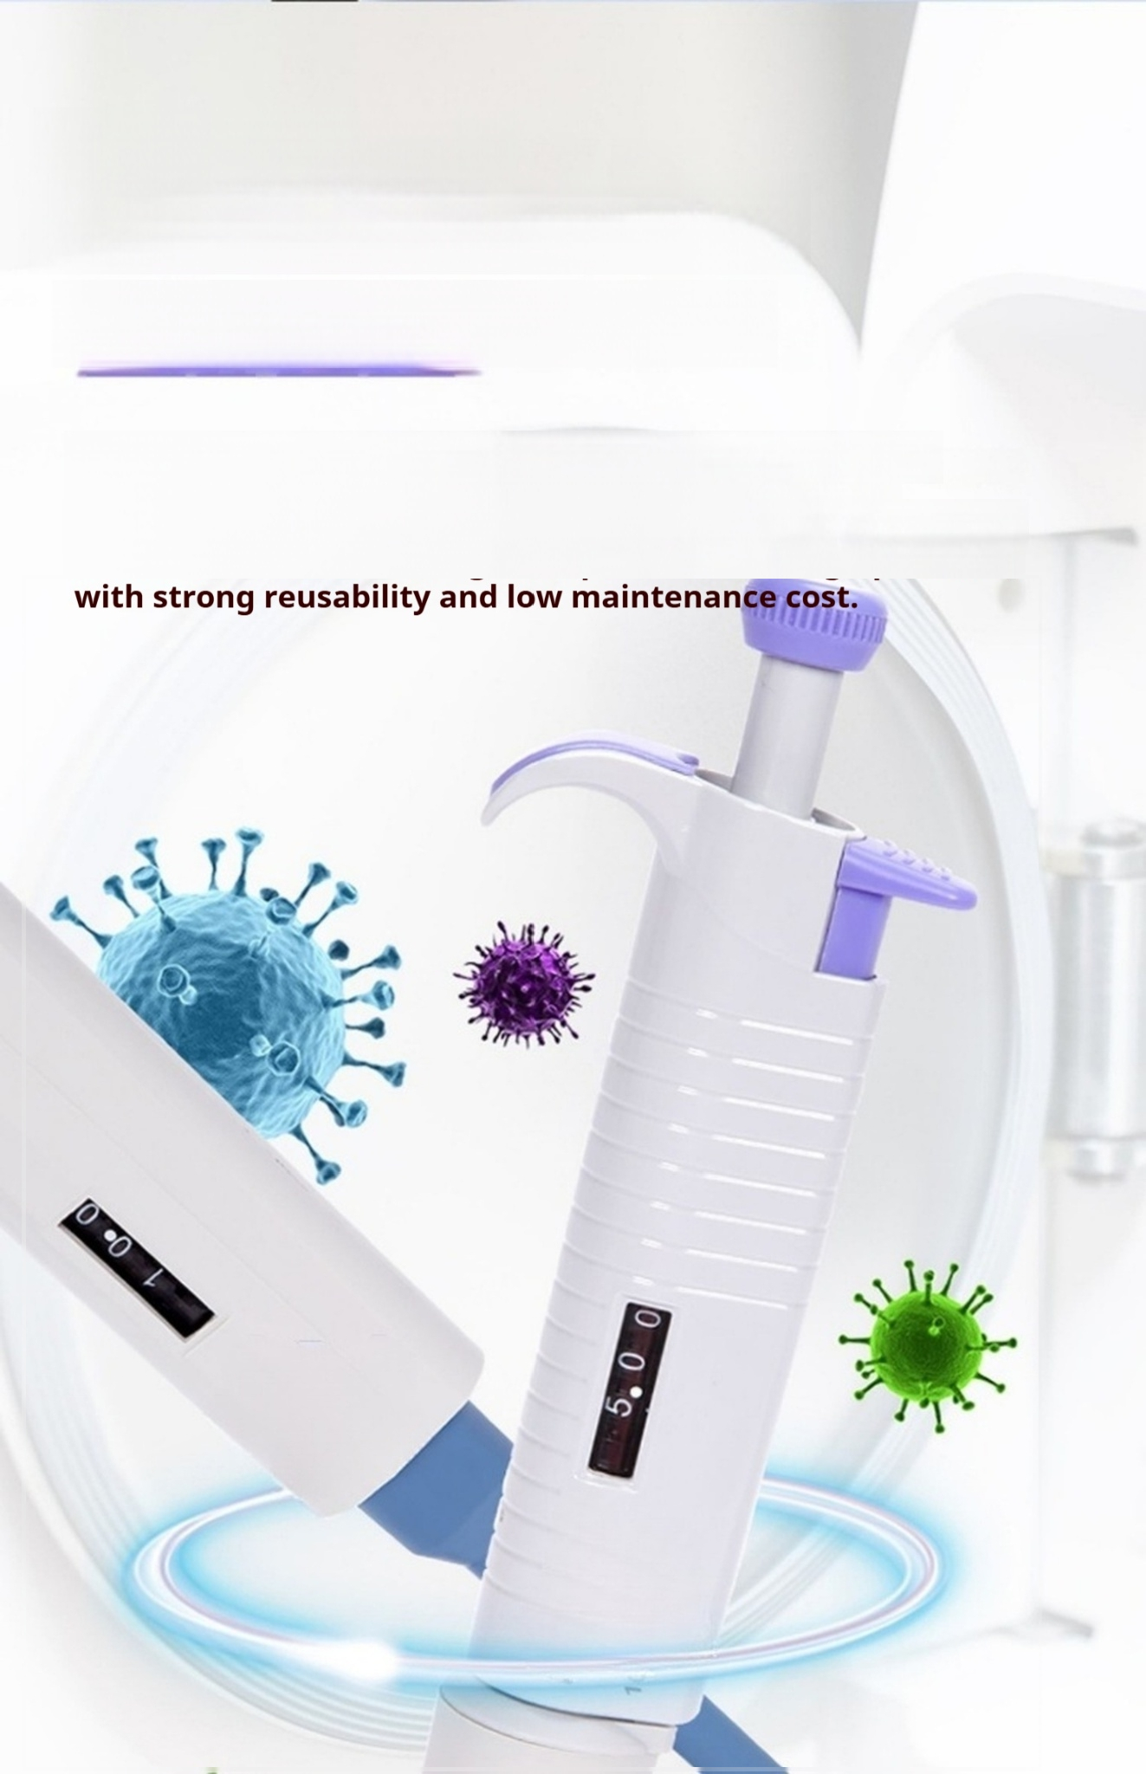
Single-channel
half-branch disinfection
Whole sterilized pipette
Blue is a half disinfection pipette,the lower half can be sterilized at 121℃ under high temperature and high
pressure,and purple is the whole disinfection pipette,which
can be sterilized under high temperature and high pressure,

Slide 11
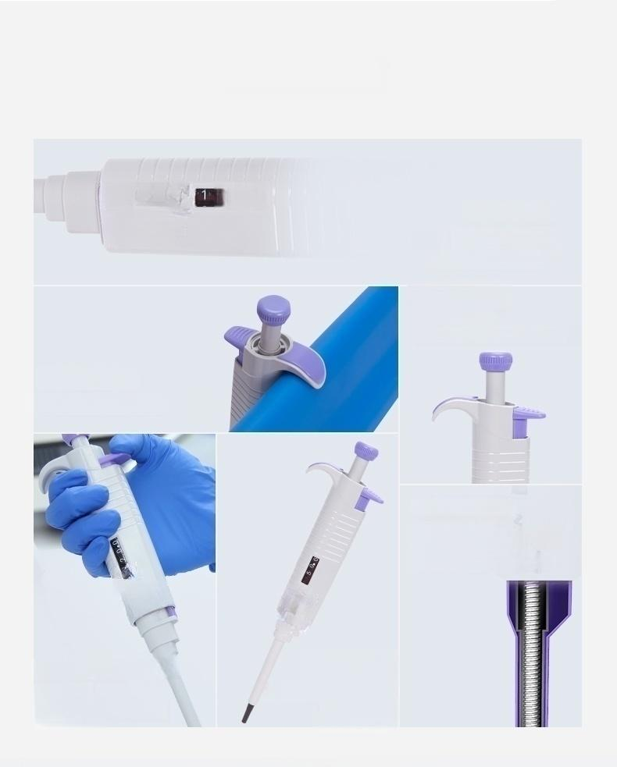
I Other Details
Other details
000
Digital Windows
Four digit display
Easy,intuitive reading
Fine-tuning
structure
Self-calibration or adjustment
Handle hook
Practicability greatly improved
High quality spring
Lightweight and low
resistance seals for
lighter operating forces
Nozzle push-out loop
Detachable
Easy to clean and maintain
ABS body
High strength plastic Sturdy and long-lasting

Slide 12
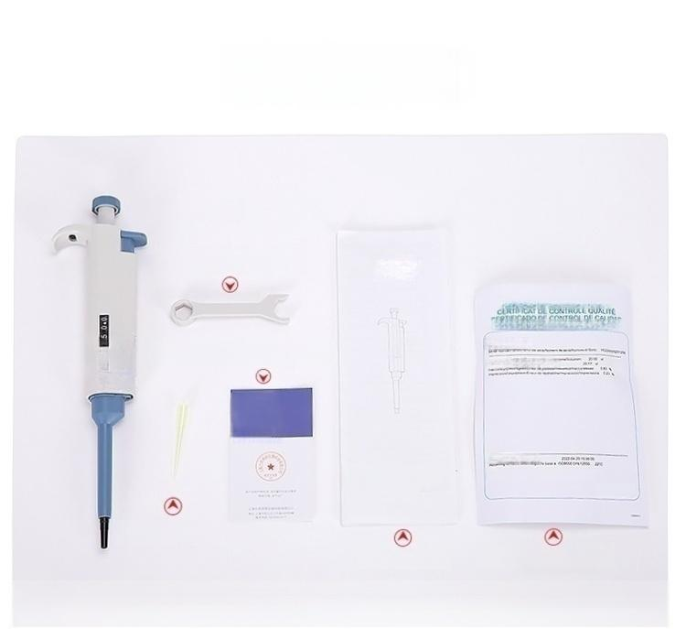
Packing List
Pipettes
Simple wrench
QUMITYCONTROL CERTIFCATE
CULIIATSKONTROL1ZERTFKT
CERTFICATO DCONTROLLOCMnm
Pote 5-504
Certificate,warranty card
uCHEN
Product quality
Instruction Manual
Small and Large Auto
Business.Bipatte
Mi
~
一
(502
Nozzle sample
User Manual Calibration Guide
Single channel semi-sterilized pipette

Slide 13
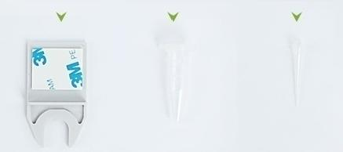


Packing List
packing list
Simple wrench Pipe grease Nozzle sample
QUALITY CONTROL CERTIFICATE QUALITÄTSKONTROLLZERTIFIKAT
CERTIFICAT DE CONTROLE QUALITE
CERTIFICADO DE CONTROL DE CALIDAD
CERTIFICATO DI CONTROLLO QUALITA
Pipette 0.5-10ul
5 e sreNec tw085ox wzL0007%!
Me Wore VeV.50u
re e 05
0 sontnev kpule 04)
ae e 5.00
始 8 .
18力位题
8*
人
Certificate/Warranty Card
DaewenDfetaDes AcesgsoNSeoS feuet,Tene | e 5S0845SDN128 zne cooa Tese (CISO 72
20221101151422
User
manual
USES
”E
orbidden
NSTRUCTAN
0Vng,dle
Calibration Guide
User Manual

Slide 14
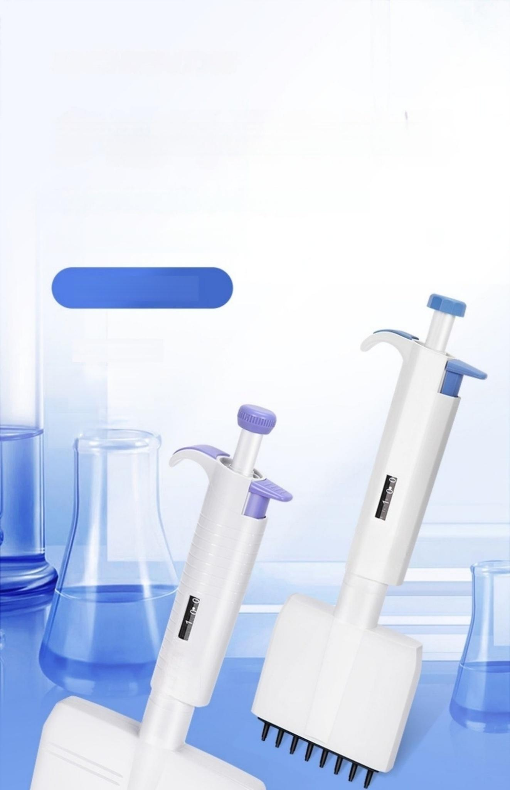
Multichannel adjustable pipette
Half-branch/whole-branch disinfection(optional)
All range:0.1uL～10ml //
8 lanes/12 lanes
● Sampling analysis
。 Precise liquid
separation
SAMPLINGANDANALYSIS
PIPETTINGACCU
RACY

Slide 15


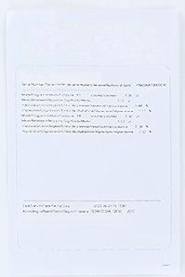

Packing List
packing list
Simple wrench Nozzle sample
Pipe grease
QUALITYCONTRCLCERTIFCATE
ceLASKeCNIRZECUALTre
CERTIFICADODE CONTROLDECALIDAD
CERTIFICATO DICONTRCLLO QUALITA
Pote8cannel05-10
-
((o
人
Certificate/Warranty Card
人
Calibration Guide User Manual

Slide 16
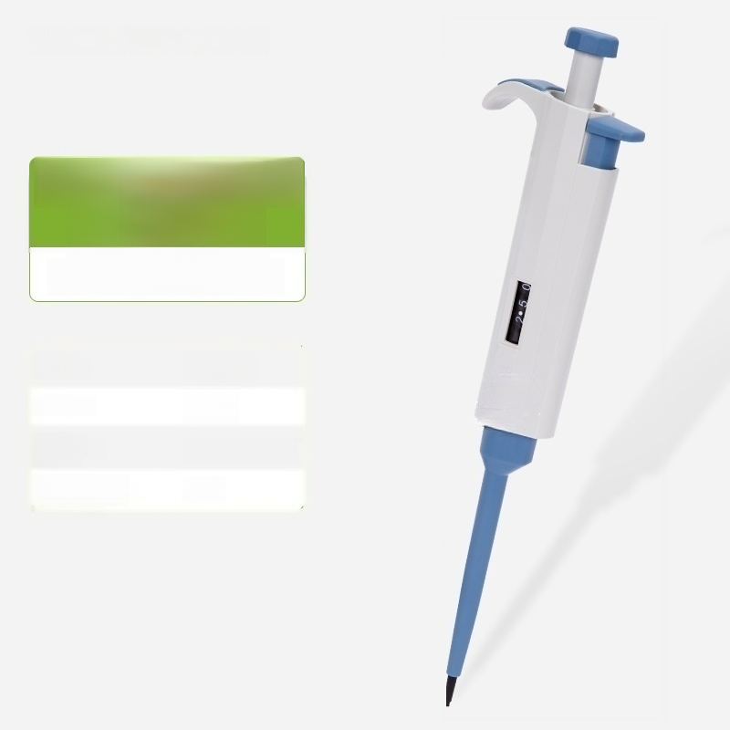
Discovery-H
0.1-2.5μl
Half sterile pipette
Range: | 0.1-2.5μl
Increment: | 0.05μl
Display mode: | PC display window
High temperature and high pressure sterilization: | Half

Slide 17
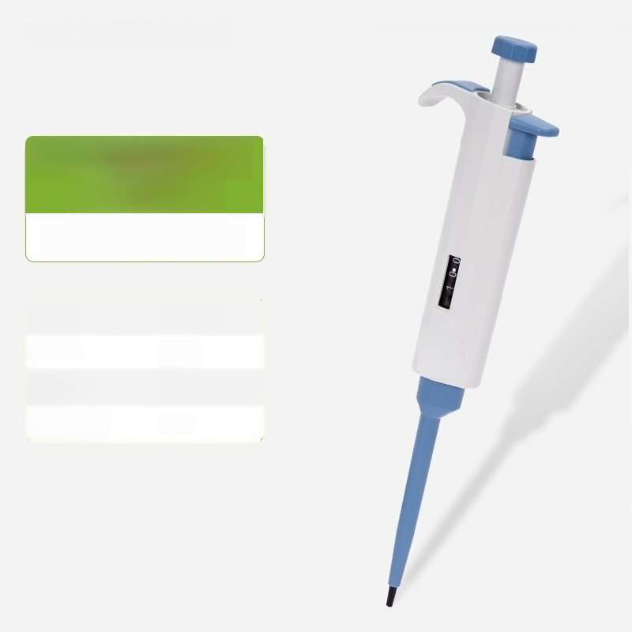
Discovery-H
0.5-10μl
Half sterile pipette
Range: | 0.5-10μl
Increment: | 0.1μl
Display mode: | PC display window
High temperature and high pressure sterilization: | Half

Slide 18
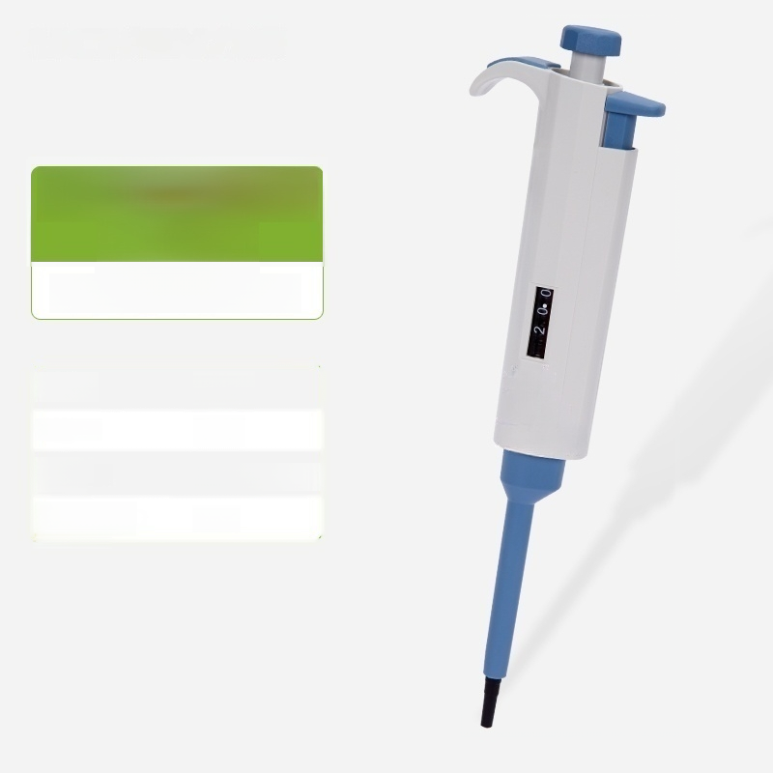
Discovery-H 2-20μl
Half sterile pipette
Range:
Increment:
Display
mode:
High temperature and high pressure sterilization:
2-20μl
0.5μl
PC display window
Half

Slide 19
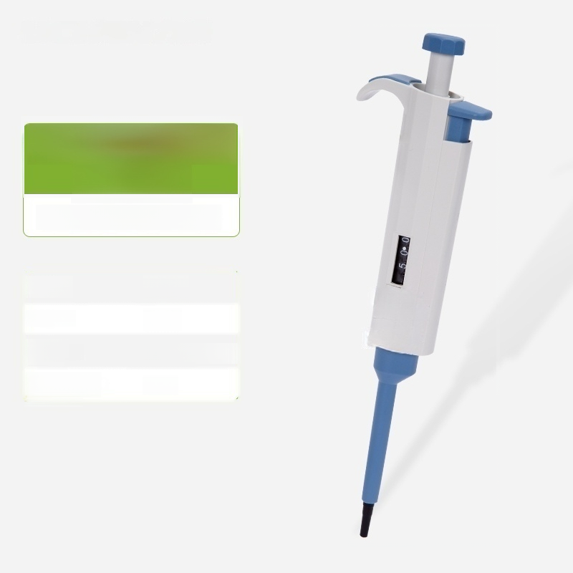
Discovery-H 5-50μl
Semi-sterilized pipette
Range:
Increment:
Display
mode:
High temperature and high pressure sterilization:
5-50μl
0.5μl
PC display window
Half

Slide 20
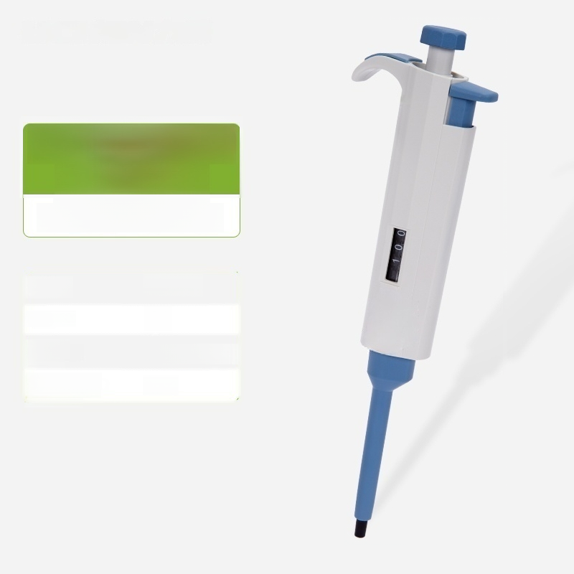
Discovery-H 10-100μ l
Half sterile pipette
Range: | 10-100μl
Increment: | lμl
Display mode: | PC display window
High temperature and high pressure sterilization: | Half

Slide 21
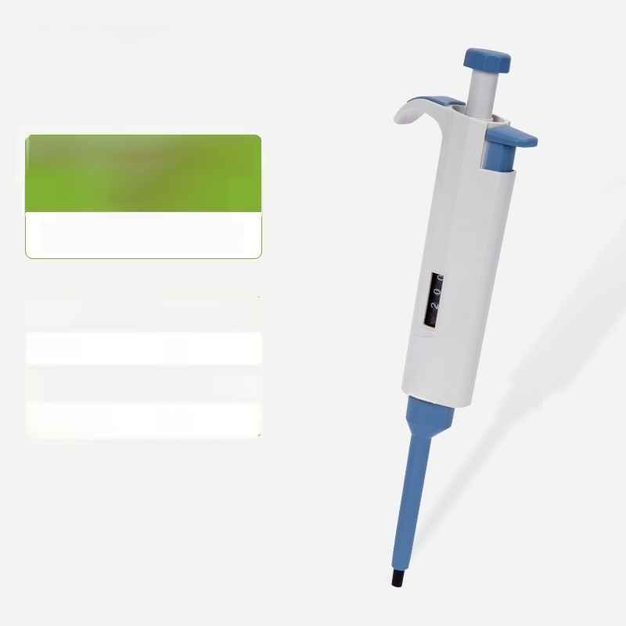
Discovery-H 20-200μl
Half sterile pipette
Range: | 20-200μl
Increment: | 1μl
Display mode: | PC display window
High temperature and high pressure sterilization: | Half

Slide 22
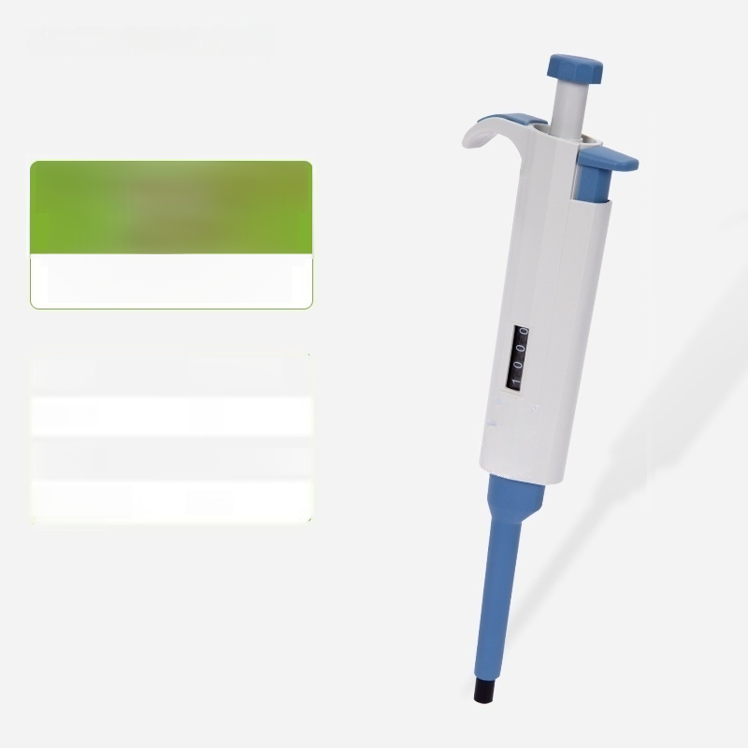
Discovery-H 100-1000μl
Half sterile pipette
Range: | 100-1000μl
Increment: | 5μl
Display mode: | PC display window
High temperature and high pressure sterilization: | Half

Slide 23
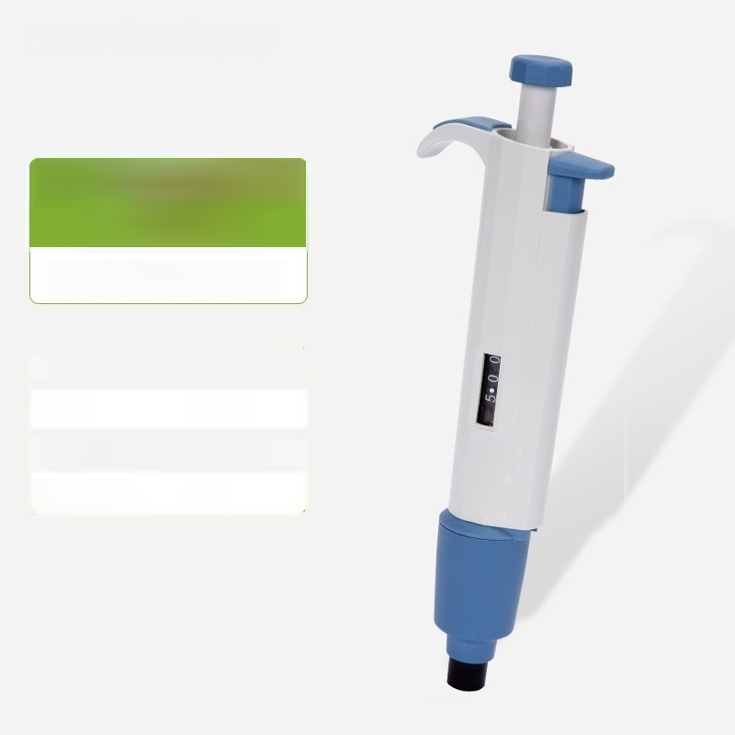
Discovery-H
0.5-5mL
Half sterile pipette
Range: | 0.5-5mL
Increment: | 0.05mL
Display mode: | PC display window
High temperature and high pressure sterilization: | Half

Slide 24

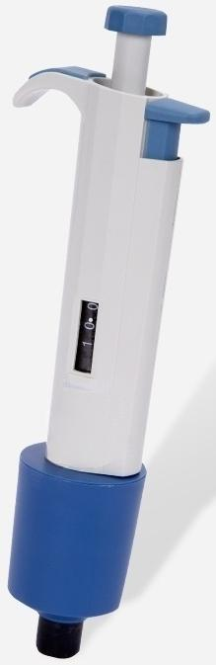

Discovery-H 1-10ml
Half sterile pipette
Range: | 1-10ml
Increment: | 0.1ml
Display mode: | PC display window
High temperature and high pressure sterilization: | Half

Slide 25
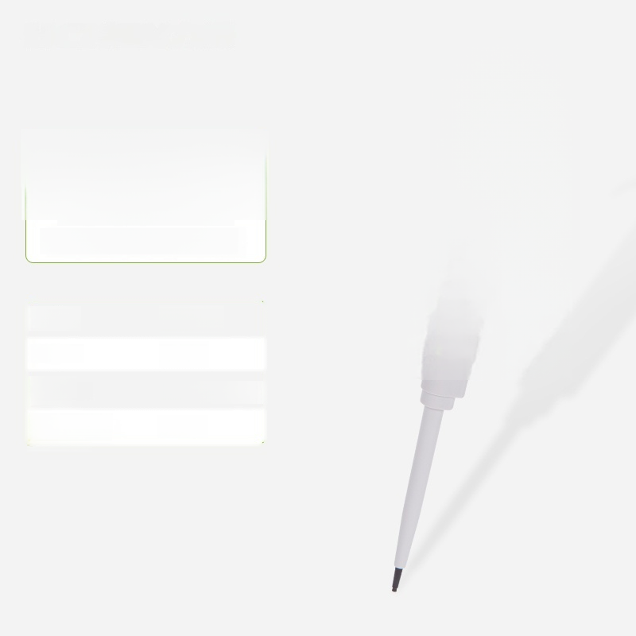
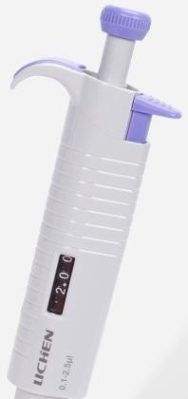

Discovery-F
0.1-2.5μl
Whole sterilized pipette
Range: | 0.1-2.5μl
Increment: | 0.05μl
Display mode: | PC display window
High temperature and high pressure sterilization: | Whole

Slide 26
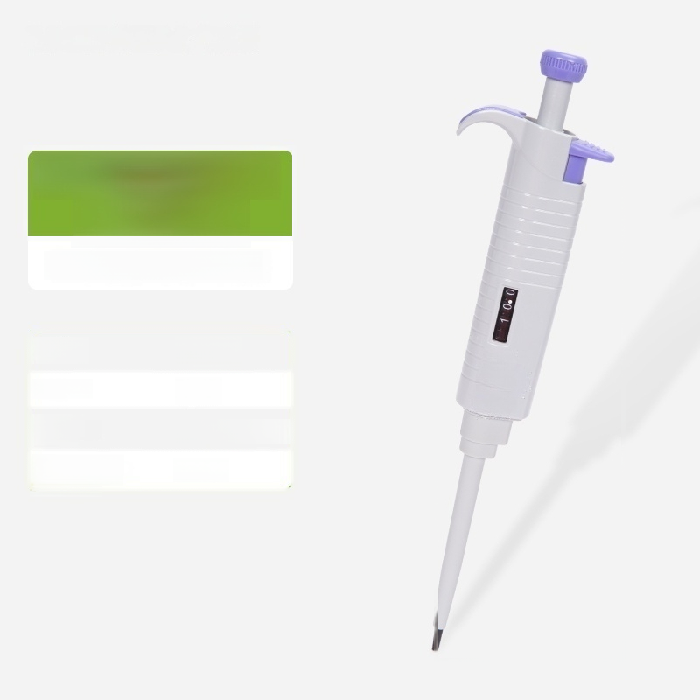
Discovery-H
0.5-10μl
Whole sterilized pipette
0.5-10μl
0.1μl
PC display window
Whole
sterilization:
Range:
Increment:
Display
mode:
High temperature and high pressure

Slide 27
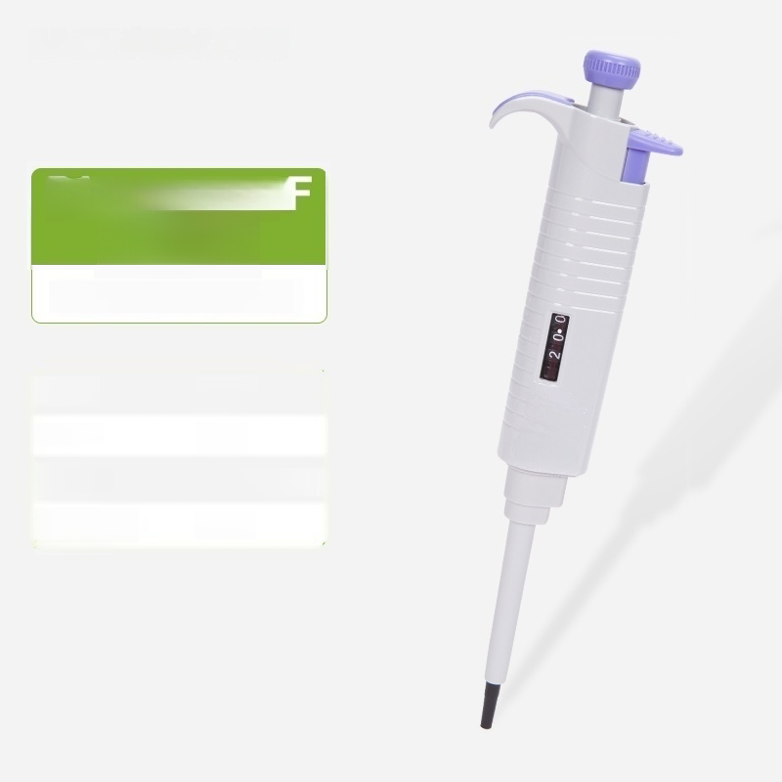
Discovery 2-20μl
■
Whole sterilized pipette
Range: | 2-20μl
Increment: | 0.5μl
Display mode: | PC display window
High temperature and high pressure sterilization: | Whole

Slide 28

Discovery 5-50μl
■
Whole sterilized pipette
Range: | 5-50μl
Increment: | 0.5μl
Display mode: | PC display window
High temperature and high pressure sterilization: | Whole

Slide 29
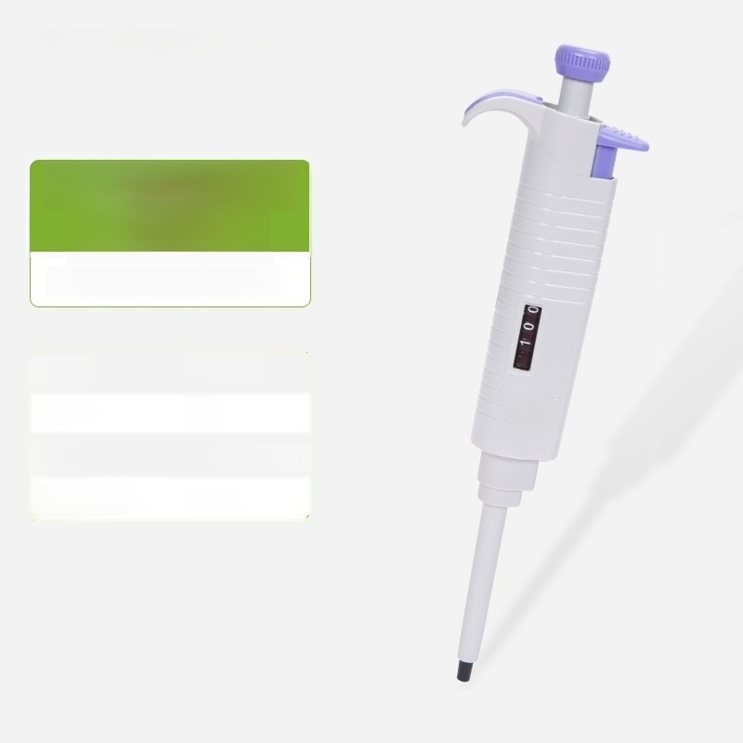
Discovery-F 10-100μl
Whole sterilized pipette
Range: | 10-100μl
Increment: | lμl
Display mode: | PC display window
High temperature and high pressure sterilization: | Whole

Slide 30

Discovery-F 20-200μl
Whole sterilized pipette
Range: | 20-200μl
Increment: | 1μl
Display mode: | PC display window
High temperature and high pressure sterilization: | Whole

Slide 31
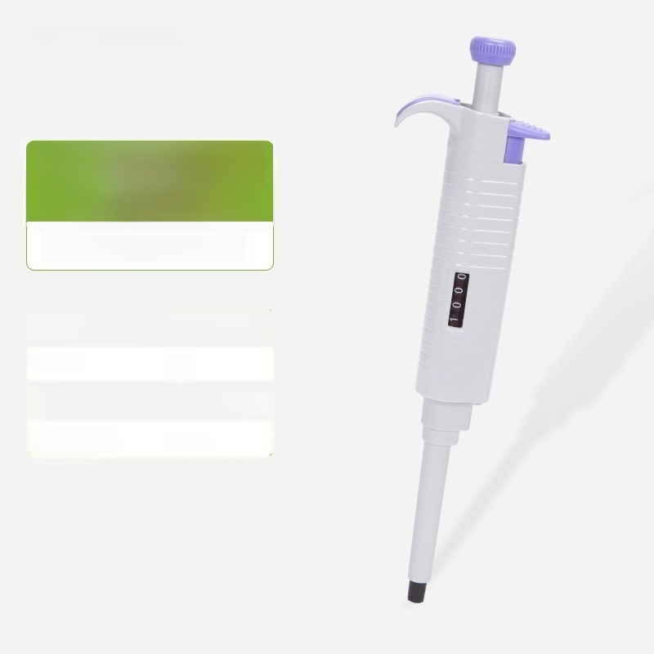
Discovery-F 100-1000μl
Whole sterilized pipette
Range: | 100-1000μl
Increment: | 5μl
Display mode: | PC display window
High temperature and high pressure sterilization: | Whole

Slide 32
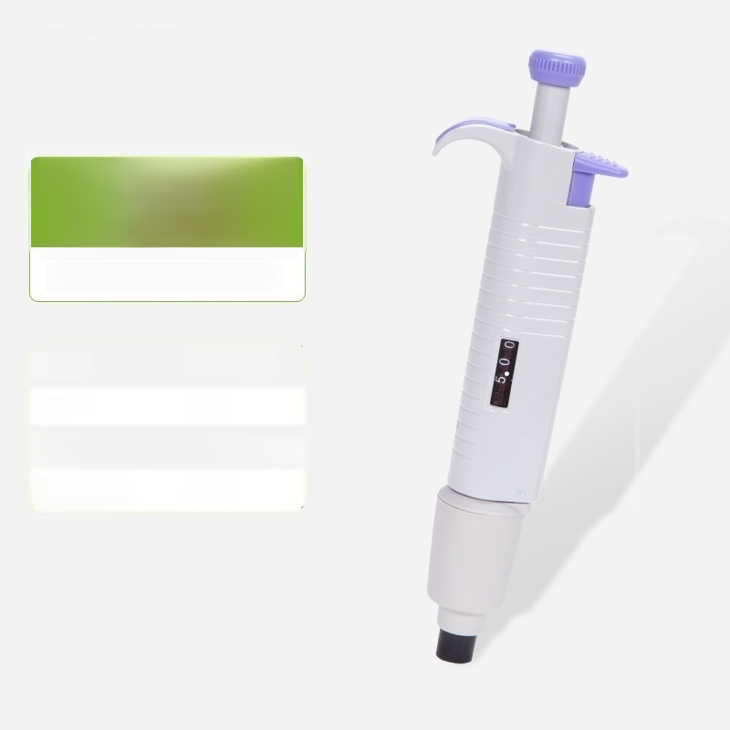
Discovery-F 500-5000μl
Whole sterilized pipette
Range: | 500-5000μl
Increment: | 50μl
Display mode: | PC display window
High temperature and high pressure sterilization: | Whole

Slide 33
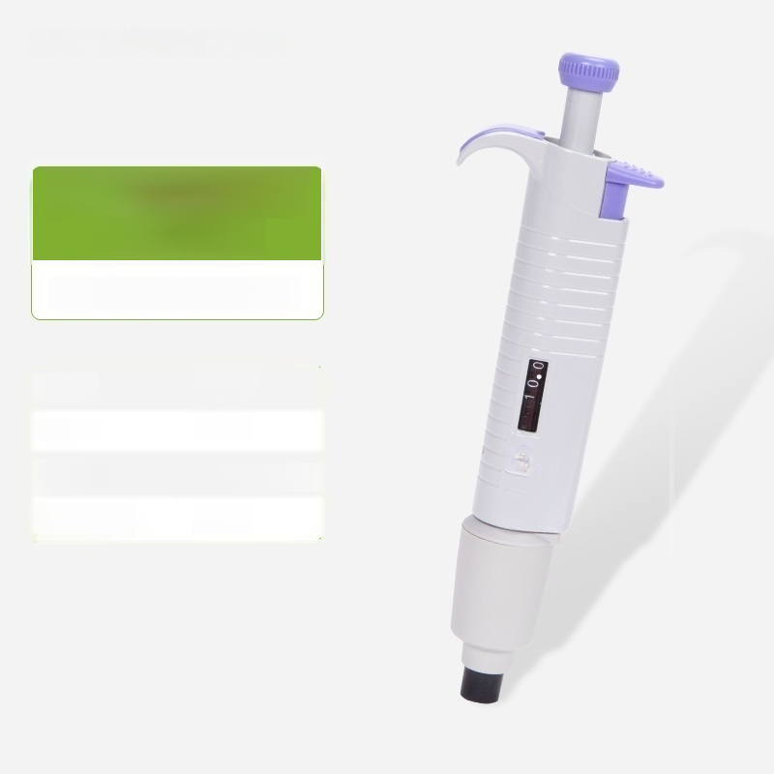
Discovery-F 1-10ml
Whole sterilized pipette
Range: | 1-10ml
Increment: | 0.1ml
Display mode: | PC display window
High temperature and high pressure sterilization: | Whole

Slide 34
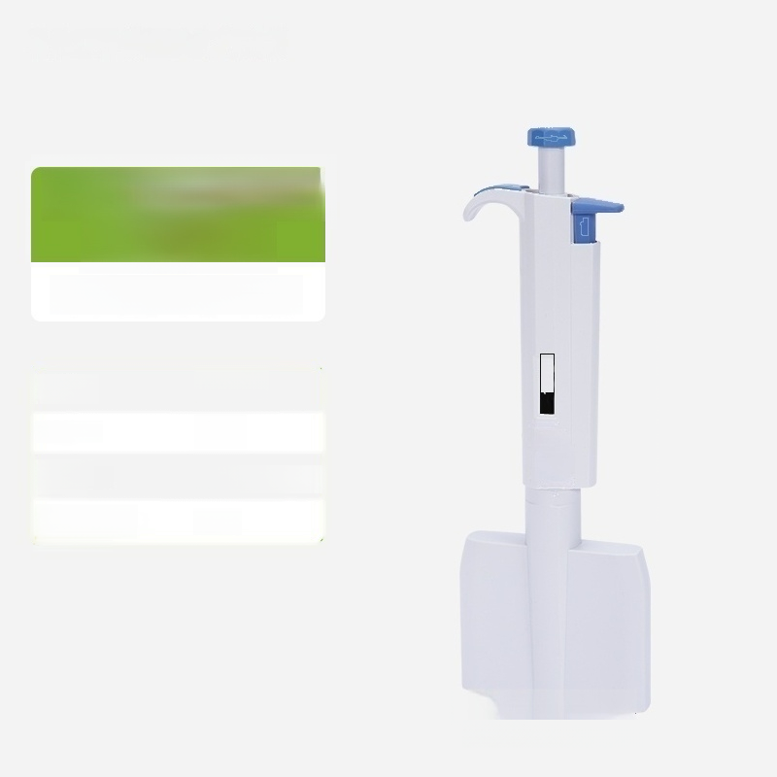
Discovery-8H
0.5-10μl
Half sterile pipette
Range: | 0.5-10μl
Increment: | 0.1μl
Display mode: | PC display window
High temperature and high pressure sterilization: | Half
10.0
TTTTTTTT

Slide 35
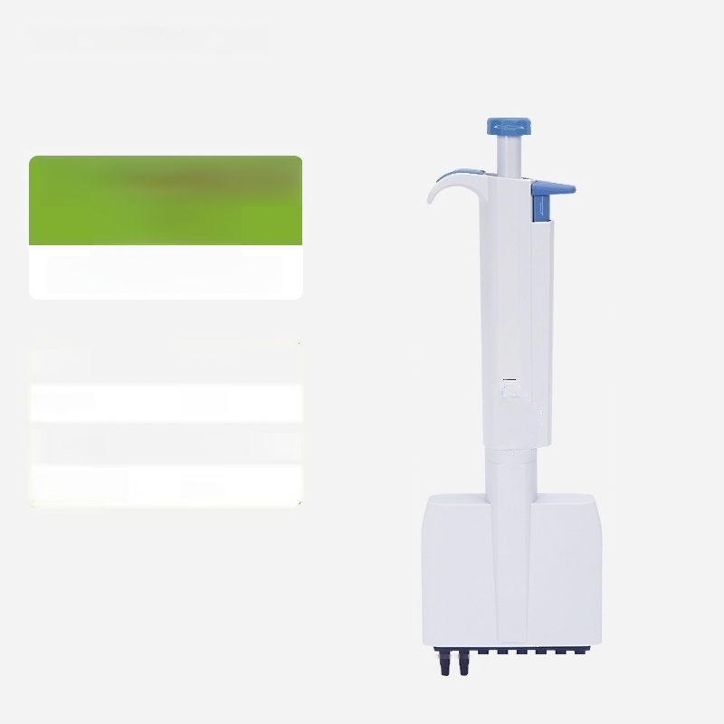
Discovery-8H 5-50μl
Half sterile pipette
Range: | 5-50μl
Increment: | 0.5μl
Display mode: | PC display window
High temperature and high pressure sterilization: | Half
50.0
IWV

Slide 36
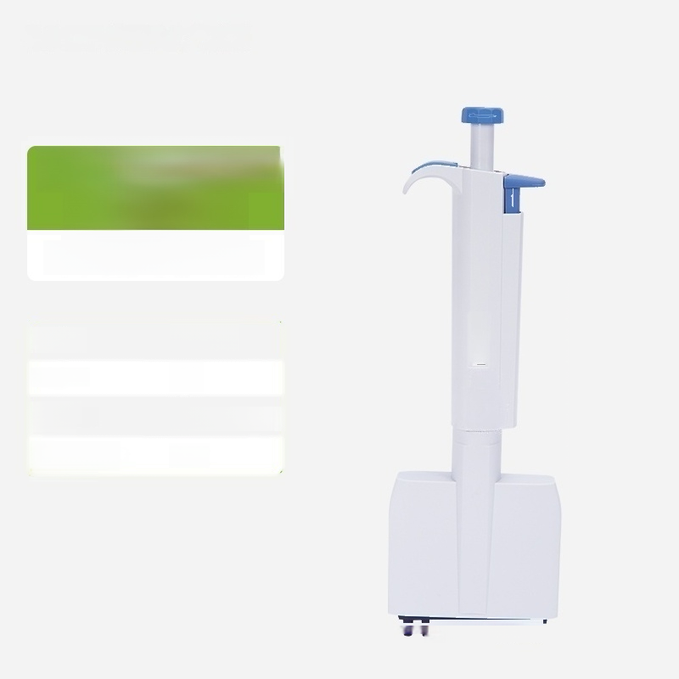
Discovery-8H 50-300μl
Half sterile pipette
Range: | 50-300μl
Increment: | 5μl
Display mode: | PC display window
High temperature and high pressure sterilization: | Half
0 0 3
UUUT

Slide 37
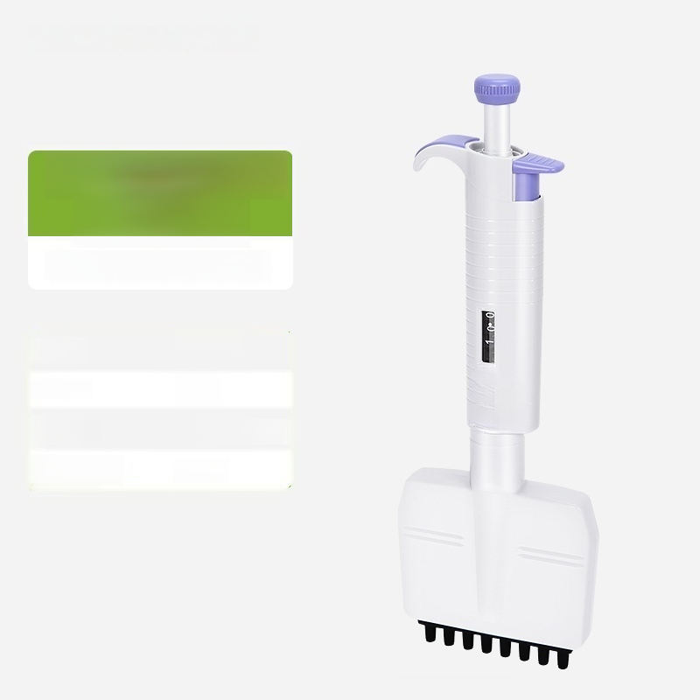
Discovery-8F
0.5-10μl
Whole sterilized pipette
0.5-10μl
0.1μl
PC display window
Whole
sterilization:
Range:
Increment:
Display
mode:
High temperature and high pressure

Slide 38

Discovery 8F 5-50μl
Whole sterilized pipette
5-50μl
0.5μl
PC display window
Whole
sterilization:
Range:
Increment:
Display
mode:
High temperature and high pressure

Slide 39

Discovery-8F 50-300μl
Whole sterilized pipette
Range: | 50-300μl
Increment: | 5μl
Display mode: | PC display window
High temperature and high pressure sterilization: | Whole

Slide 40
