Slide 1
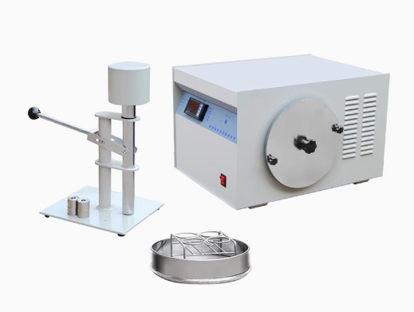

Slide 2
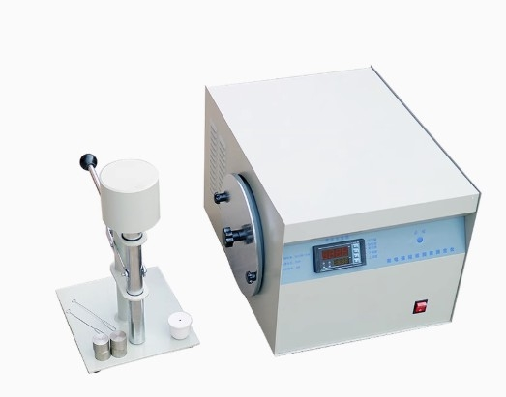

Slide 3
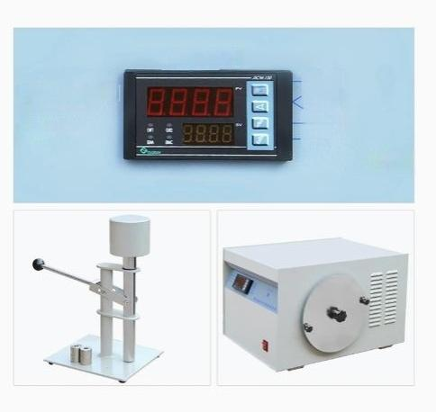
Power failure does not lose count
Set Key
shift key
Reset key
Down key
Upkey
Drum speed:50±2RPM
Powesupplywolnge ZN
Motor power:28W
Microelectic

Slide 4
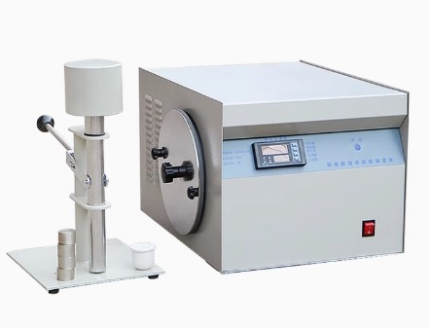

Slide 5
LC-NJ-100A
LC-NJC-50A
PRODUCT MOD | E LC-NJ-100A | LC-NJC-50A
nput power suPP | AC 220V/50Hz | AC220V/50Hz
Motor Fower | 28W(energy-saving type) | 40W
Drum rotational s | e 50+2rpm | 50+0.5rpm
speed range | 1-999rpm | 1-999rpm
Display mode | LED digital tube | Touch screen display
Extermal dimensid | ns 500*460*330mm | 480*420*320mm
net weight | 45kg | 30Kg
LC-NJ-100A product features 1. The instrument is a special instrument for measuring the bonding ability of coking coal -- bonding index and Roga index.
2. The drum sensor adopts integrated electronic switch, which has the characteristics of long service time and strong anti-interference performance.
3. The reducer does not need to be filled with oil, which solves the problem of oil leakage of the reducer.
4. No need to set the number of drum rotation, computer automatic control.
5. Automatic memory of startup times.
6. Display mode: LED digital display, manual reset or boot automatic reset.
LC-NJC-50A product features 1, drum sensor adopts integrated electronic switch, with long service time, strong anti-interference performance;
2, the reducer does not need to add oil, to solve the problem of oil leakage of the reducer;
3, do not set the number of drum, automatic memory start times, you can directly set the speed setting;
4, display mode: touch screen display, manual reset or boot automatic reset;
5, the measuring instrument is equipped with set counting and other programs, can automatically identify the counting pulse, counting accurate, simple and convenient operation;
6, the instrument contains national standards, such as customers forget or unclear experimental equations can check the national standards for comparison;

Slide 6
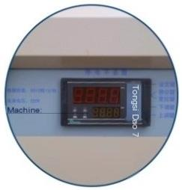
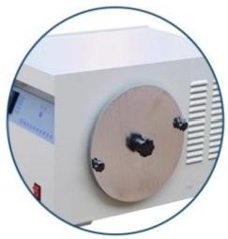
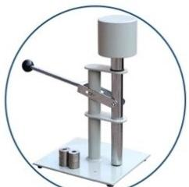
LED digital display
LED digital display,manual eset or automatic reset upon startup.
Automatic memory function
Automatic memory activation times.
automation
No need to sot the numbor of drum cycles,computer
automatic control.

