Slide 1
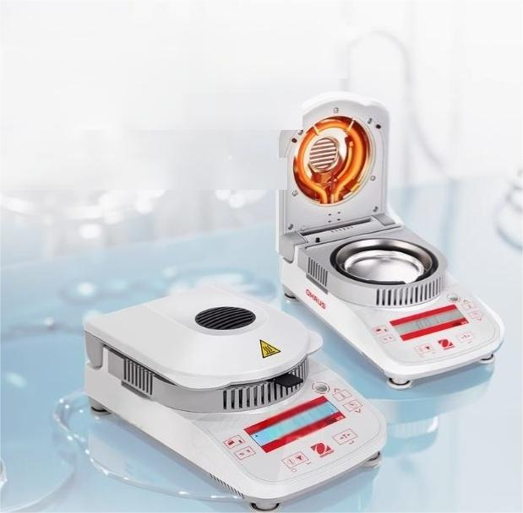
A fast moisture meter makes the experiment more efficient
New generation moisture meter MB model
Uniform heating Itemperaturecontrol weighinglaccurate measurement

Slide 2
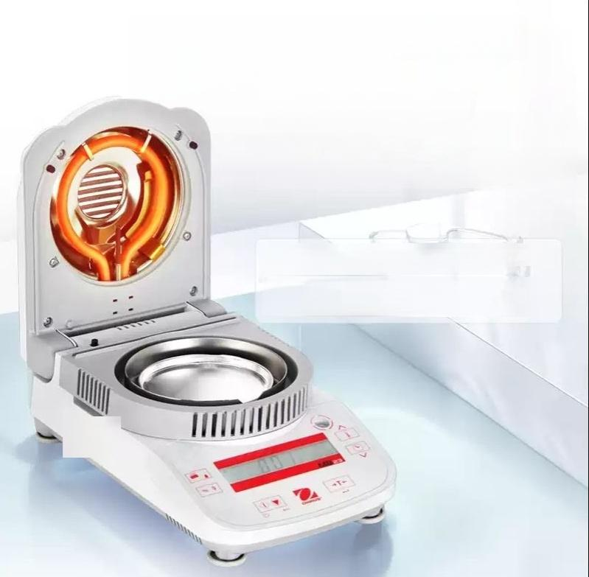
Uniform heating and accurate
weighing
0.1%/0.01%heating range 50°C to 160°C
MB23(Infrared Heated Moisture meter)-Suitablefordetermination of samples with high sugarcontent orothereasily scorched samples.
MB25,MB27(Halogen heated moisture meter)-Uses the rapid drying method to dry the sample and automatically calculates the moisture, suitableforthedetermination of samples requiringrapid heating.

Slide 3
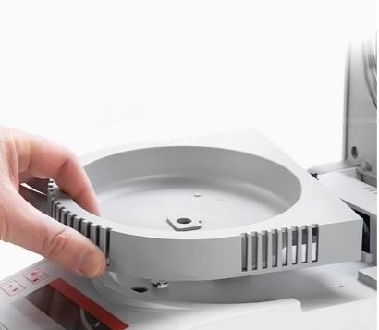
Detachable cavity
The design of the heating chamber is easy to clean,and the compact design can
effectively save space.

Slide 4
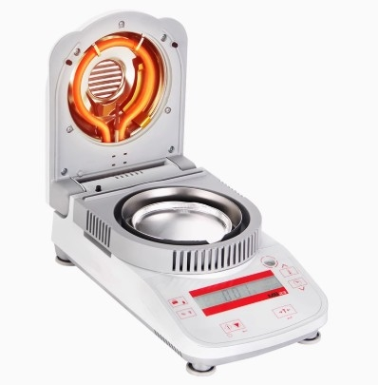

Slide 5
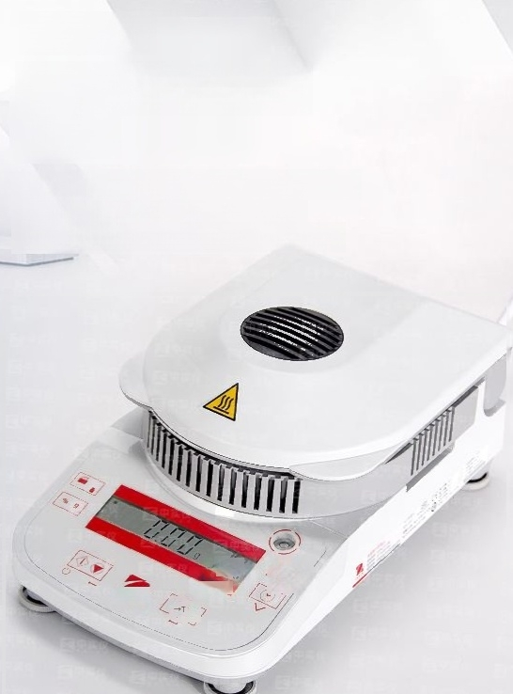

Durable
insulation easy to
clean
The control panel is also equipped with a transparent protective cover to
prevent liquid splashing on the panel

Slide 6
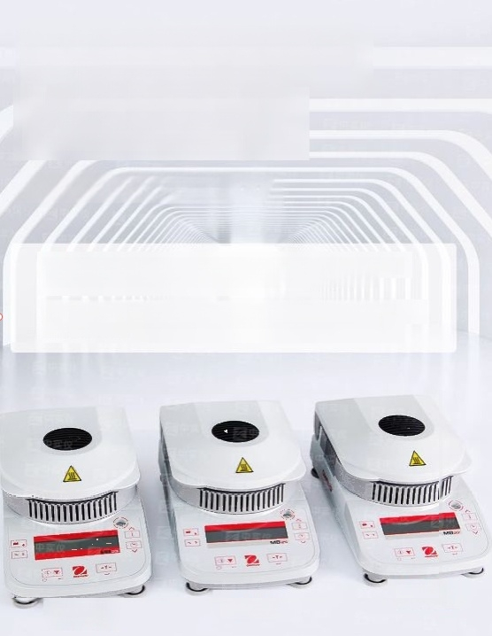
Samples with different
properties choose
different models
MB23/MB25/MB27
The MB23non-glassinfrared heating unitenables uniform heating and is particularly suitable for moisture determination in food,wastewater and ceramic products
MB25/MB27 Halogen lamp heating waterproof caneffectively reduce heating time, simple and easytoclean heating chamberto meet your frequent use and reduce
maintenance costs.
MB25
MB27
MB23

Slide 7
MB23,25,27 basic moisture meter
Technical parameters
Model number | MB23ZH | MB25ZH | MB27ZH
Material number | 80252471 | 80252473 | 30128007
Range(g) | 110 | 110/99 | 90
Readability (g Readability(>10g sample)(96) Repeatability(3gsample)(96) | 0.01 | 0.01/0.005 | 0001
 | 0.10% | 0.05% | 0.01%
 | 0.30% | 0.20% | 0.20%
Repeatability(10g sample)(%) | 0.20% | 0.05% | 0.05%
Minimum sample size(g | 0.5
Recommended sampe st | 3~20
Pan size (mm) | 090
Heat program | Standard
Ambient operating temperature (C | 10C~30°C
Communication | two-way RS232
End point control | Timing and automatic
Heating temperature range(C) Display contents | 50°Cto 160°C(5°Cinterval)
 | Moisture%,solids %,weight,time,temperature
Heatingtime Overall dimensions (widthxheightx length)(mm) Netweight (kg) | 30 seconds for Ito60 minute intervals and 1 minute for 60 to90 minute intervals 165x127×280
 | 2.1
Total weight(kg) | 4.15 | 4.2
Sample plate handle | Standard configuration
Heating Source | Infrared | Halogen

Slide 8
Other features: Easy operation-No complicated menu,6 buttons to complete the whole operation easily. Standard RS232 communication interface-easy to connect to printers,computers and other peripherals. ,MB23(Infrared Heated Moisture Meter)-Suitable for determination of samples with high sugar content orother easily scorched samples. MB25,MB27(Halogen heated moisture meter)-Uses therapid drying method to dry the sample and automatically calculates the moisture,suitablefor the determination of samples requiring rapid heating.
Backlit LCD display-makes the screen clearer and brighter,and provides rich determination information.
Excellent performance-Insulated weighing sensor technology is used to prevent the heating process from affecting weighing accuracy.
Flexible heating method

Slide 9
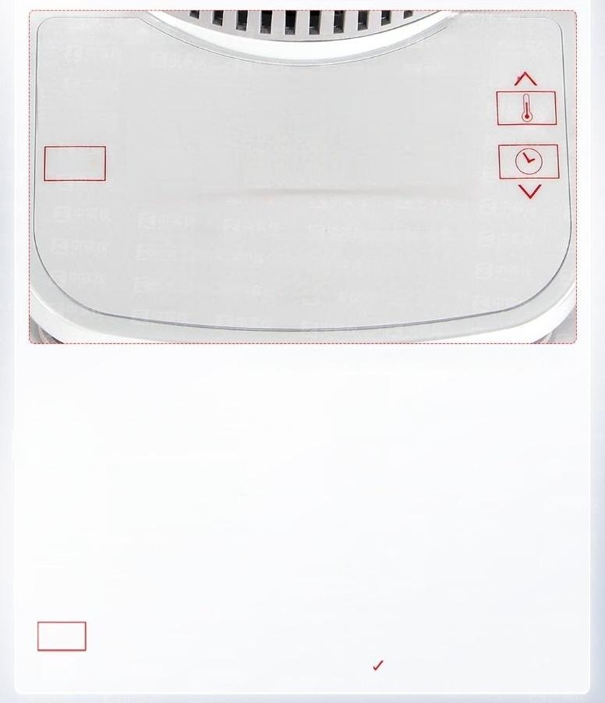


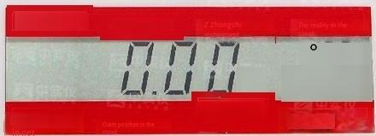










Garden shiyi
米
10:00
Zone Out
Realinstrument
Z ZhongmaiYi
%g
g
MB23
The top right comer is the horizontal bubble.Adjust the bottom knob to show the bubble to the center
Power on(shortpress)/Power Off(longpress)
Start/stop test (short press)
Set temperature(short press)
Start/stop ^{To} ^{return(short} ^{press)}
Peeling(short press)
Confirm that the current test is over/start the next one Test(short press)
Peeling Accept the current setting(short press)
Print (short press)
Calibrate (long press)/Show Print/calibrate RS232 Settings(on standby)
Temperature
Set the time (tap)
Value increase (short press to increase in turn or long press to scrollto
increase)
Time
Select
% g
%g
Value reduction (short press sequential reduction or long press rolling
reduction)
Test result switch key (short press)
Select

Slide 10
MB120,MB90 moisture tester
Technical parameters
Model number | MB120ZH | MB90ZH
range | 120g | 90g
readability | 0.01%/0.001g | 0.01%/0.001g
Repeatability | 0.05%(3g sample) 0.015%(10g sample) | 0.18%(3g sample) 0.02%(10g sample)
Moisture value range | 0.01%～100% (0.01%to 1000%moisture regain mode) | 0.01%~100% (0.01%to 1000%moisture regain mode)
Temperature range | 40°~230℃ | 40°℃~200°℃
exportation | RS232(2),USB h | ost (2),USB device
Heating unit | Halo | gen heating
Power supply | 240 VAC50/60 Hz
Operating temperature | 10℃~40℃
Displayscreen Display results Sample tray Size Overall Dimensions(WxHxD) Net weight Shipping size (WxHxD Shipping weight | 4.3',QVGA,TFT color touch screen %Moisture content,%solids content,%moisture regain,time,temperature,weight,method name,curves and statistical results 90mm
 | 211×180×355mm
 | 5.23kg
 | 440×470×540mm
 | 8.35kg

Slide 11
Other features: ABS high strength plastic,stainless steel sample tray handle and stainless steel sample tray holder, protective cover,7 shutdown modes and 4 heating modes optional,can store 100 test methods and 1000 test results,intuitive User wizard,heatingtemperature 40-230℃(1°℃for incremental adjustment of heatingtemperature),13languages optional(only display,can not be input) High strength ABS plastic case,stainless steel sample tray handle and stainless steel sample tray holder, protective cover,3 shutdown modes and 2 heating modes optional,can store 2 test methods and 100 test results,intuitive user guide,heating temperature 40-200℃(1℃for incremental adjustment of heating temperature),13 languages optional(only display,can not be input)
MB120
MB90

Slide 12
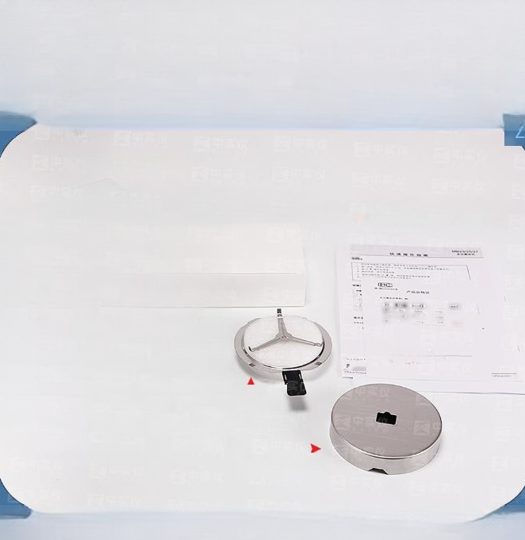
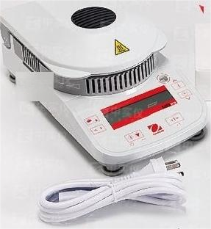
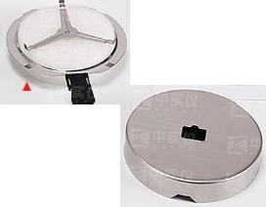
Packing
list
Host machine
Sample tray 1 box
Instruction manual/Certificate of
conformity
Sample tray holder/handle
A Power cord
Sample tray base

