Slide 1
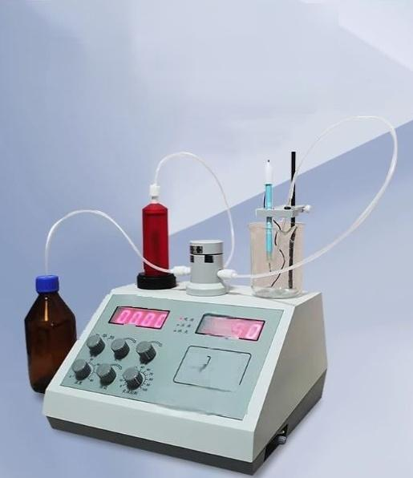

Potentiometric
titrator
Automatic fast/eye-catching and intuitive/easy to operate
作 为 PH/m
.FEA?
shanghai Benpin science
ontvequprentCO,LTD

Slide 2
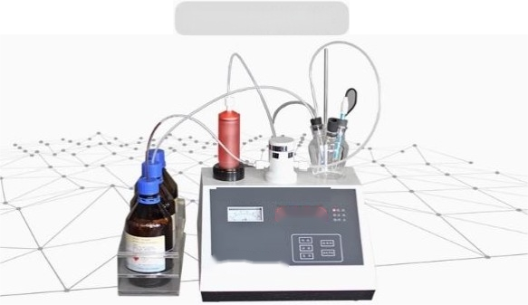
MA-1A moisture tester
Product Features
1,large LCD liquid crystal display,intelligent operating system,
man-machine dialogue is flexible and convenient,the basic operation of the computer can be easily mastered;
2,the newly added ammeter makes the titration process moreintuitive;
3,the whole liquid circuit is made ofspecial materials.Strong corrosion resistance,can ensure long-term continuous work
4,fully closed system,avoid the infiltration of environmental water
5.Use the electrode polarization voltage tojudge and displaythe reaction end point and terminate the titration.
6,the use of ordinary test(dissolving)agent bottle cap as ajoint,easyto replace

Slide 3

Technical parameter
Measuring range:
30PPM-100%(H20 mass
Moisture titration repeatability: <0.01
Resolution:
fraction) 0.01milliliter
Linear correlation coefficient ofmoisture titration:
>0.998
Sensitivity:
10-6A
Capacity error: ·±0.002
Burette
Greater
capacity: than 25ml

Slide 4
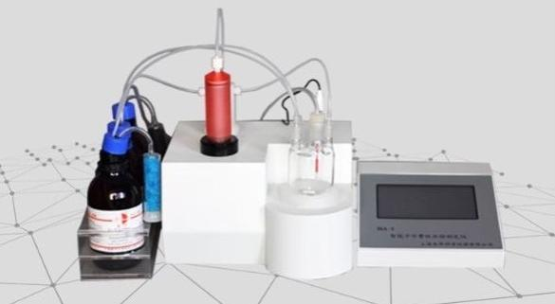
Product introduction
MA-1moisture tester

Slide 5
Product characteristics
1,large LCD liquid crystal display,intelligent operating system,man-machine dialogue is flexible and convenient,the basic operation of the computer can be easily mastered;
2,according to the actual situation of the sample,adjust the accuracy,titration speed,stirring speed,end time delay;
3,the dynamic display of color titration curve during the titration process can more intuitively browse more instrument parameters and analysis
results information,but also can identify and determine possible side reactions at the best time,in order to inhibit it
4,moisture tester moisture content test results are automatically stored,optional printer;
5,built-in dedicated fully enclosed intelligent titration system,for stirring and replacing
titration solvent,just on the touch screen operation,without opening the reaction cup,it
can be through the built-in multi-function pump,to achieve waste liquid and add new
solvent(methanol).Shorten the balance time,but also reduce the escape of organic solvents and accumulation in the air,to protect the health and safety of the operator.
6.The experiment is separated by a longtime(generally more than 10days),and the remaining Karl Fischer reagent in the metering tube can be injected backinto the reagent bottle to reduce the waste of reagents.This step only requires the
operation of the touch screen.
Technical parameters
Measuring range: ^{Moisture} ^{content} ^{resolution:} ^{Meteringtube} ^{resolution:}
^{10PPM-100%(H20} ^{mass} ^{fraction)} 1ppm _{0.001milliliter}
Moisture titration repeatability: Linear correlation coefficient Capacity error.
<0.005 of water titration:>0.999 _{±0.0002}
Relative error.
<0.2%
Sample testing
time:30S-90S

Slide 6
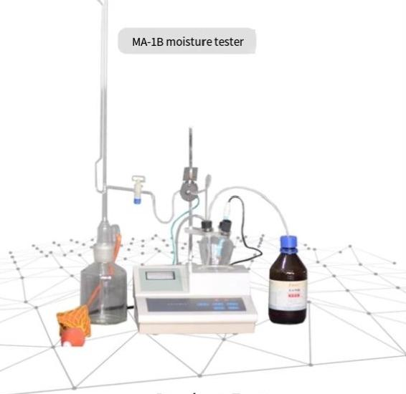
Product Features
1,manual automatic two methods ofoperation,the use ofsolenoid valve to adjust the size of the measuredflow,
Automatically indicate the end point:
2,afterthe beginingof the detemination,the instrumentautomatically adjusts the rapid titration accordingtothe moisture content
3.The end point automatic locking deviceis provided with the end point red light indication
4.Automatic waste discharge device,no need to manually removewaste liquid,safe and convenient to use;

Slide 7

Technical parameter
Relative standard deviation: Supply voltage:
<2% Ac 220±22V
Measuring range:
0.03 to 100%

Slide 8
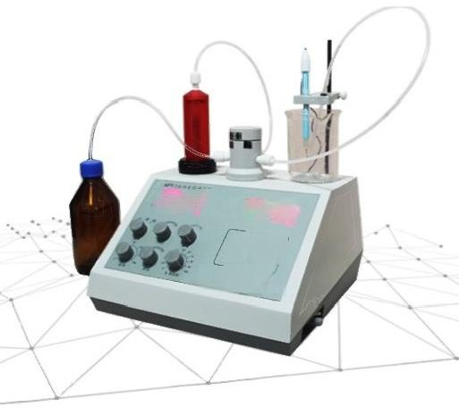
APT-1 titrator
⁰⁰⁰⁰ 13
PH/m
^{四} 哥
SaghsQmxie
instrument set imited bis
Product Features
1,because the instrument is more miniaturized,the instrument can be used as a PH meter in the laboratory,and its accuracy is consistent with PHS-3C.
2,in the titration analysis,the end potential is preset,the input potential
value after titration,whether it is positive potential or negative potential,
whether the titration potential is larger or smaller,positive or negative,there is an automatic polarity reversal circuit inside the instrument.And automatically track the end potential,the operator does not have to flip any control switch,so that it is convenient to use,but also improve the control accuracy.
3,in the PH measurement,the panel uses poten tiometer and band switch control and switch,so that the user choose automatic tiration and manual titration are very convenient.
In the titration analysis,the use of high reliability touch key control,

Slide 9
Technical parameter
Measuring accuracy: ^{Potenial} ^{control} ^{accuracy:}
Measuring range:
PHO~1400pH value
MVO~±1999mv
Input impedance:
Not less than 1x10°0
PH0~±0.01 MVO.1%F ·time
±0.03pH value
Or3MV
Volume analysis repeatability: Not greater than 0.3%F·S

Slide 10
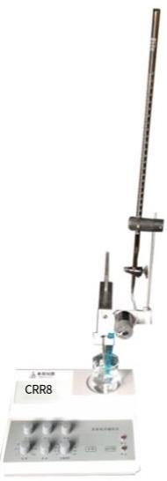
APT-2 titrator
Product Features
1,because theinstrument is more miniaturized, The instrument can be used as a PH meter in the laboratory,and its accuracy is consistent
with PHS-3C.
2,in the titration analysis,pre-set the end
potential,input potentialvalue atertitration, whether it is positive potential or negative
potential,whether the titration potential is
larger orsmaller,positive or negative,the
nstrument has an automatic polarity reversal circuit,and automatically track the end
potential,the operator does not have toflip any control switch,so that it is convenient to use, And improve the control accuracy
3,in the PH measurement,the paneladopts the
potentiometer and band switch control and switching, in the titration analysis,the use of highly reliable touch key control,so that the user choose automatic titration and manual titration are very convenient

Slide 11
Measuring range: PH value：0-14.00-PH MV:0-±1999 MV | Technical parameter
 | PH value：±0.01 f.s.MV:0.1% | Potential control accuracy ±0.03PH value Or±3MV
Input impedance: | Volume analysis repeatability: Appearance size:
Not less than 1x10°Q | Notgreater than 0.3%F-S 280×200×130mm

