Slide 1
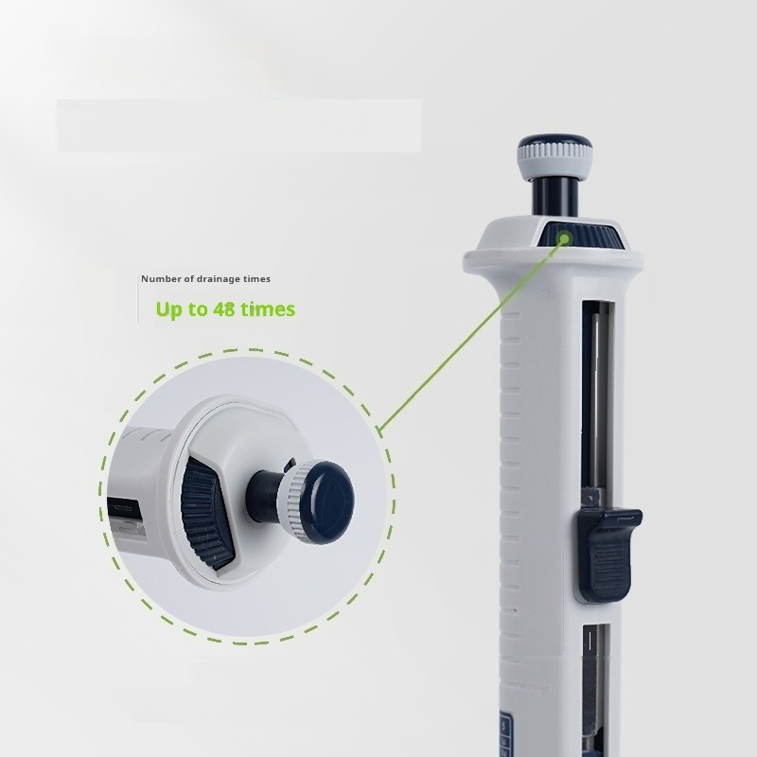
Efficient pipetting
」
Different discharge capacity can be set
Only one pipetting can complete up to 48 liquid
separation operations.Continuous and efficient
5
Number
of gears
Gear Adjustment
(Rotate the adjusting wheel left and right to
set the discharge volume)
liquid separation,improve the efficiency of users.

Slide 2
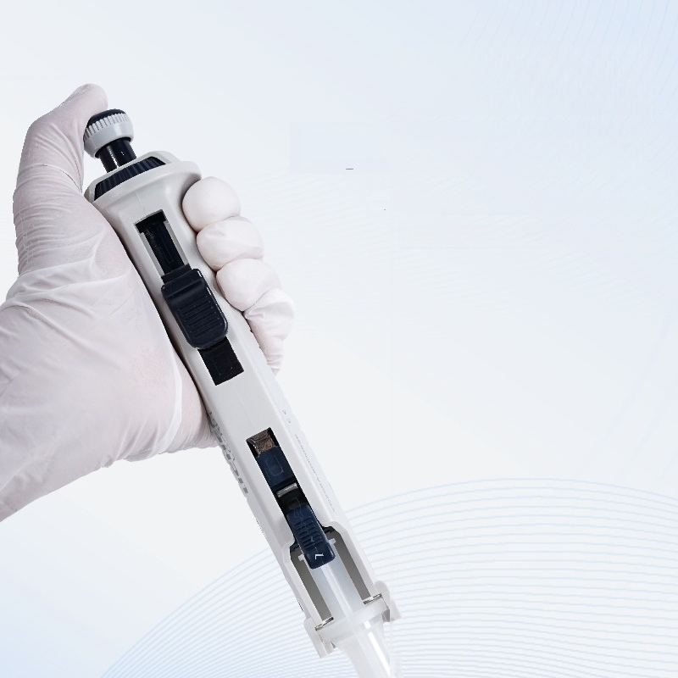
「
Easy to operate
Ergonomic design
Operates easily with one hand,conforms to Ergonomic design,reduces user fatigue
上

Slide 3
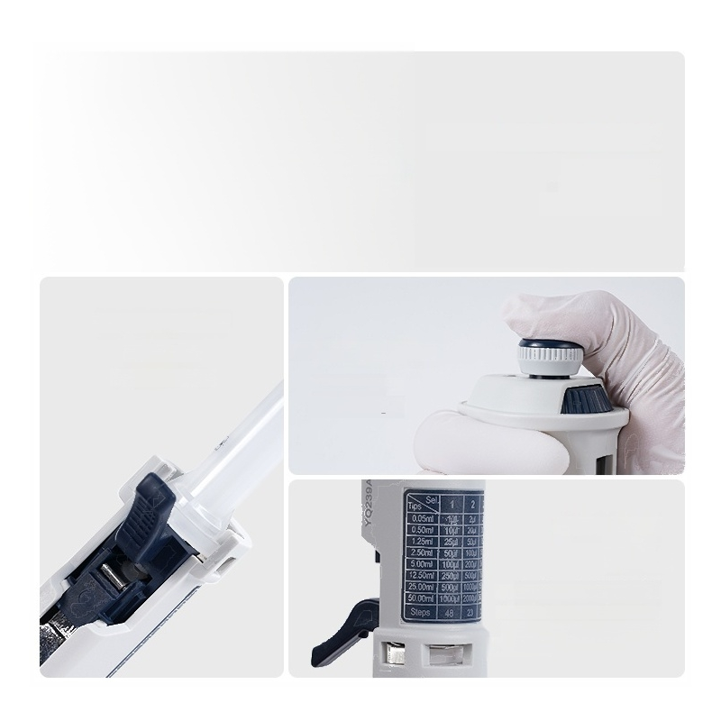
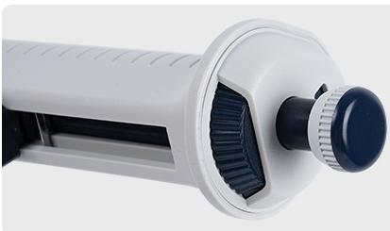
Liquid volume setting dial
Turn the dial Set the liquid dispensing gear
Nozzle locking rod
Fixed lock
Dispenser nozzle
Dispensing button
Light operating force
Reduce fatigue
Quick search
Range
Contains five gear combinations Seven range specifications distributor Nozzle corresponds to liquid dispensing volume

Slide 4
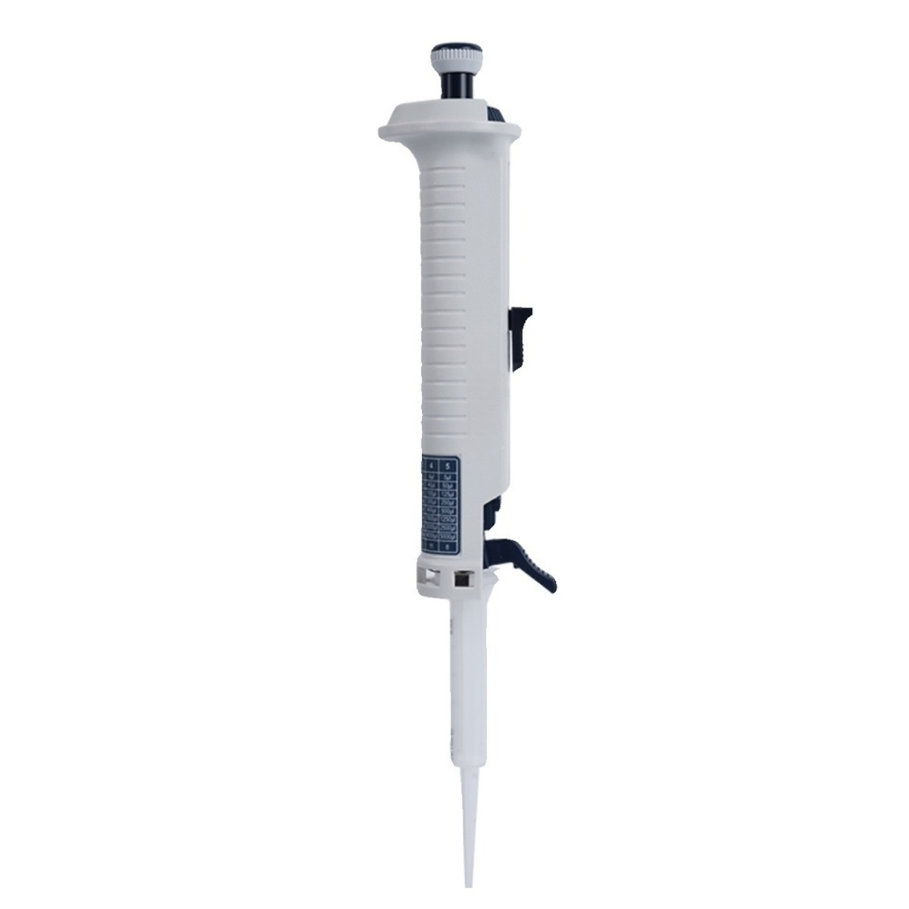

Slide 5

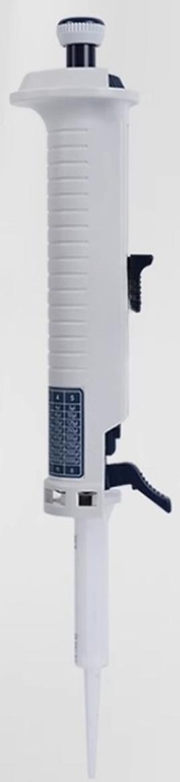
Continuous manual distributor
Precise and effortless liquid separation operation
LC-RPT Series
Selection of a new generation of laboratories
The cho oratories

Slide 6


1 Product parameter details
Product parameters
Note:During continuous liquid dispensing operations,please discard the first and last dispenses.
Product Model Number of files setting Number of drainage times Distributor nozzle Range(ml) 0.5 1.25 2.5 5(Standard configuration) 12.5 25 50 Net Weight Product Size L×W×H) | LC-RPT 10μl~5ml
 | 1 | 2 | 3 | 4 | 5
 | 48 | 23 | 15 | 11 | 8
 | Sample volume(ul) |  |  |  |  | A% (Accuracy) | P% (Precision)
 | 10 | 20 | 30 | 40 | 50 | ±0.8 | ≤0.7
 | 25 | 50 | 75 | 100 | 125 | ±0.8 | ≤0.5
 | 50 | 100 | 150 | 200 | 250 | ±0.8 | ≤0.4
 | 100 | 200 | 300 | 400 | 500 | ±0.4 | ≤0.3
 | 250 | 500 | 750 | 1000 | 1250 | ±0.3 | ≤0.3
 | 500 | 1000 | 1500 | 2000 | 2500 | ±0.2 | ≤0.3
 | 1000 | 2000 | 3000 | 4000 | 5000 | ±0.2 | ≤0.2
 | 0.097kg
 | 190×63×44mm

Slide 7
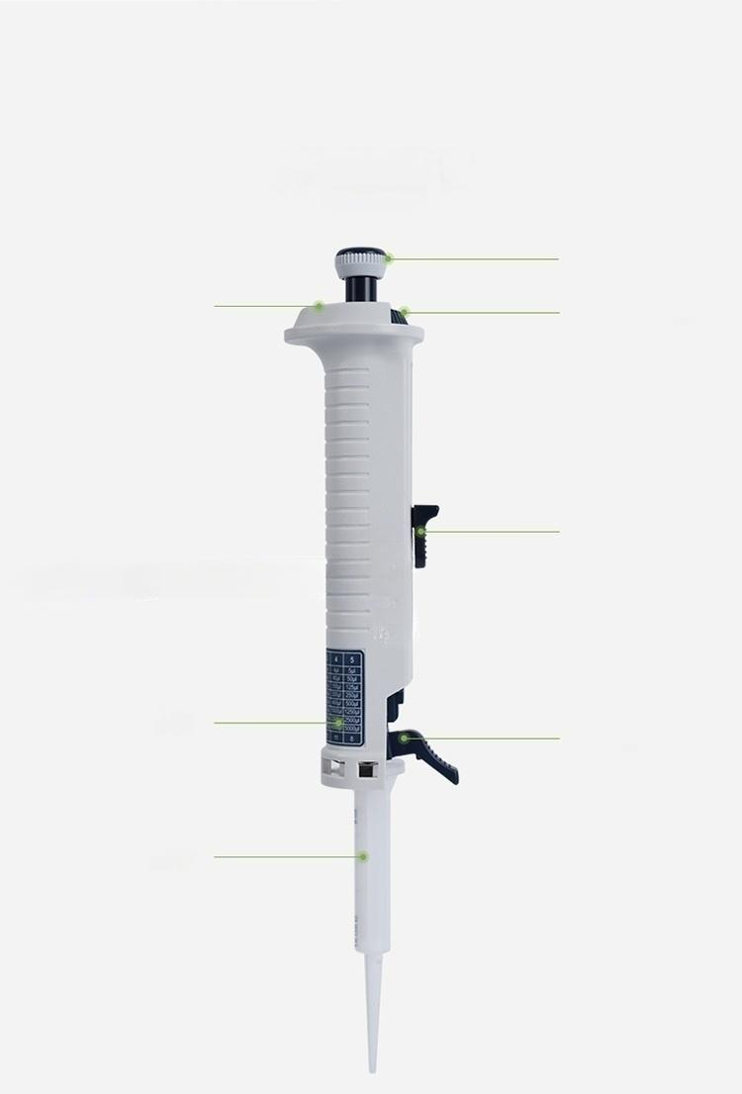
Instrument details
Instrument details
Dispenser
button
Liquid volume setting dial
Suction
rod
Locking
lever
Gear display
Bidirectional scale table
Distributor nozzle

Slide 8
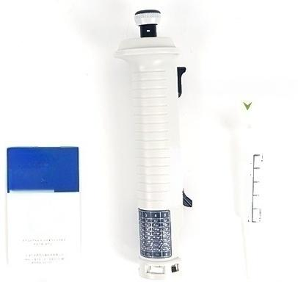


I instrument list
List of instruments
5ml dispenser tube tip
Product | [ h
quafity
certiicate
^{U} ^{er} ^{m} ^{al} _{l}^{n}_{i} _{r}
人
User manual
C
cte
s
a
nu
o
e
Vs
teefioN
c
a
a
tio
M
^{里} manual
dispenser
人
Certificate,warranty card ^{人}
Connected continuous manual dispenser

Slide 9
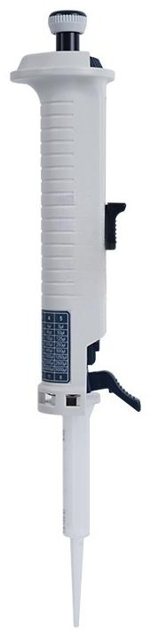
LC-RPT
Continuous manual distributor
Number of gears setting: | 1、2、3、4、 | 5 | Drainage times: | 48、23、15、11、8
Net Weight: | 0.097kg |  | Product Size: | 190×63×44mm
Dispenser nozzle range:0.5ml、1.25ml、2.5ml、5ml、12.5ml、25ml、50ml

