Slide 1
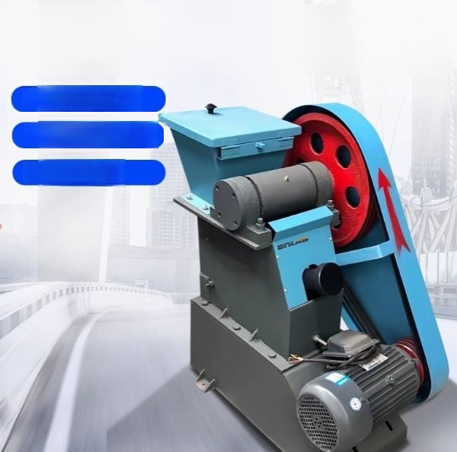
Negative suspension jaw crusher
High degree of
fragmentation
Uniform particle size of fragmentation
Durable and wear-resistant

Slide 2
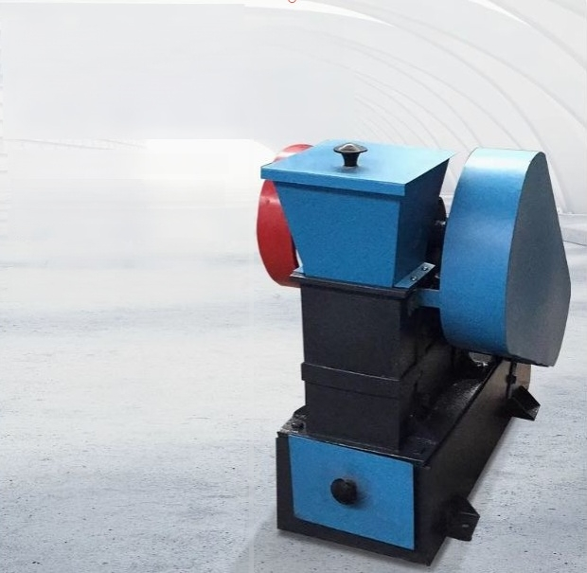
The body adopts two
structural forms
The body adopts two structural forms.
One is of asingle-piece casting.
Another method involves welding with high-qualitysteel
plates:
Using safe and high-performance features.
The operation is simple.

Slide 3
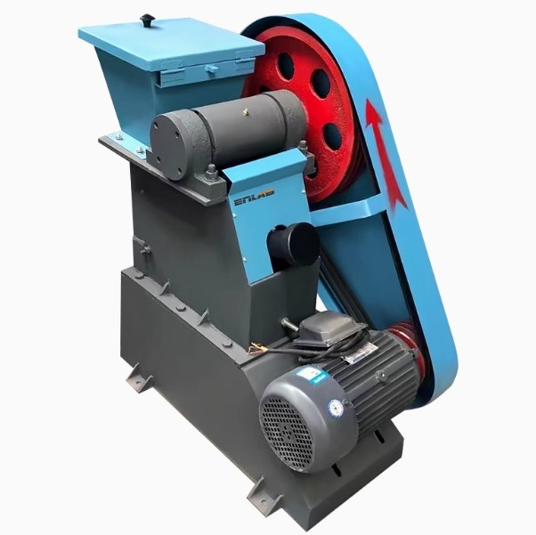

Slide 4
Product parameters
model | Negative suspension jaw crusher 100*60 | Negative suspension jaw erusho 100*125 | Negative suspension jaw crusher 125*150
Power supply(v) | 380 | 380 | 380
Motor power(kw) | 1.5 | 3 | 3
Feeding port size(m | m) 100×60 | 100×125 | 125×150
Loading particle siz | e(mm)≤50 | ≤80 | ≤100
Discharge particle size(m | m)3-13 adjustable | 6-30 adjustable | 6-35 adjustable
Production efficiency | (kg/h) 200 | 300-800 | 300-1000
Product size(mm) | 780×440×640 | 960×540×1000 | 960×550×1000
Net weight (kg) | 75 | 200 | 210

Slide 5

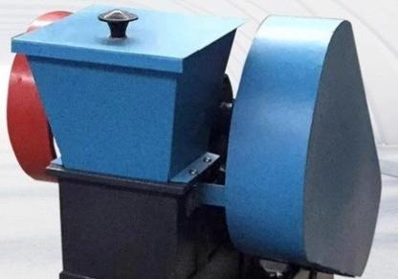
The body adopts
Two structural forms
The body adopts two structural forms,one is cast as a whole and the other is
welded with high-quality steel plates:safe to use,superior in performance,and easy to operate;

Slide 6
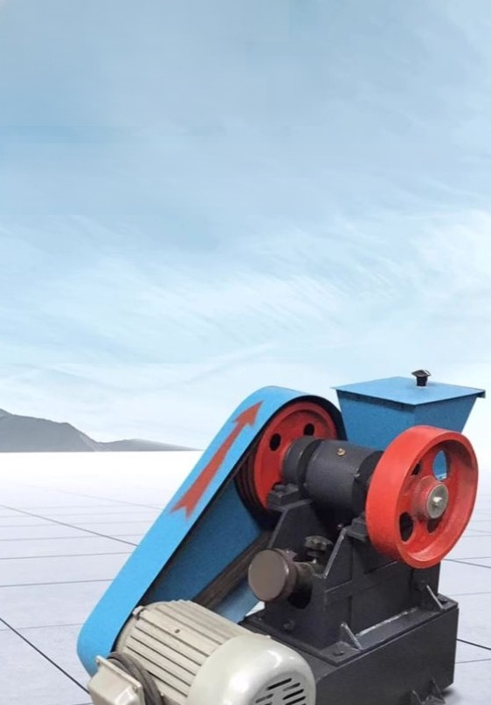
The discharge port is
equipped with an
adjustment device.
The discharge portisequippedwith an adjustment device.Itnotonly enablesthe adjustment of the gap between the discharge port,but also serves asan insurance mechanism:when the
feedingload is excessive orwhen an ironobjectis encountered,itwilfirstbreak,causingthe machine to stopworkingand protecting other partsfrom beingdamaged.

Slide 7
Packing List
Serial Number | Name | Quantity
1 | Host machine | One unit
2 | Corresponding accessories | 1 set
4 | User Manual | 1 copy
5 | Certificate of Conformity/Waranty Card | One copy

