Slide 1
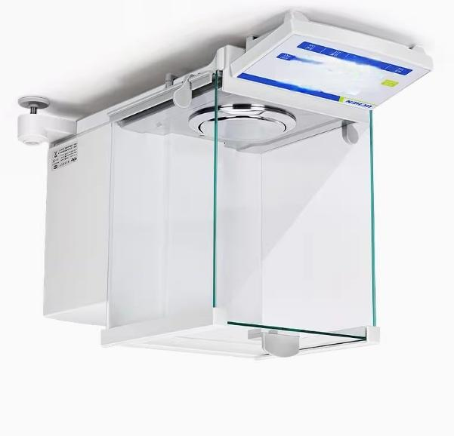
DO

Slide 2
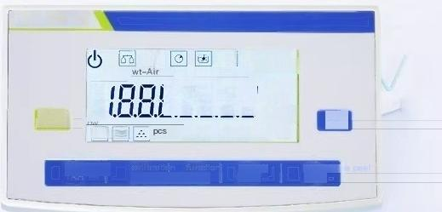
LCD display with clear
display and simple operation
8 weighing modes and 5unit conversions
LICHEN
Max=888g
d-088 mg
high
wt-liquid
88888
%k g/cm2cm2 lb
ct
Wich ON/OH
oz
mgr
print
PRT
A
^{Pwe} ^{th} _{CAL}
FUNC
set up
STE
remove t
TAR

Slide 3
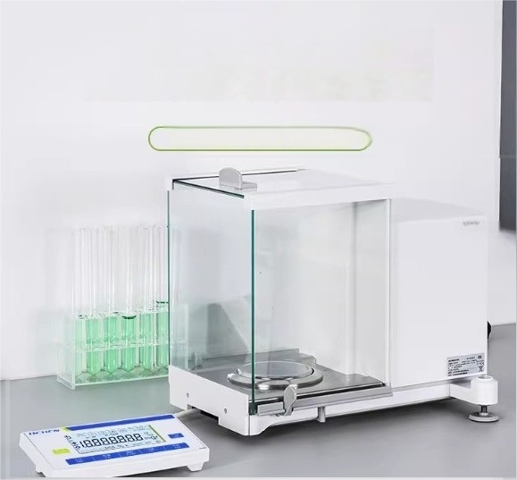
Semi micro electronic analysis balance with strong anti-interference and
stable weighing
ES series(for external/internal schools)

Slide 4
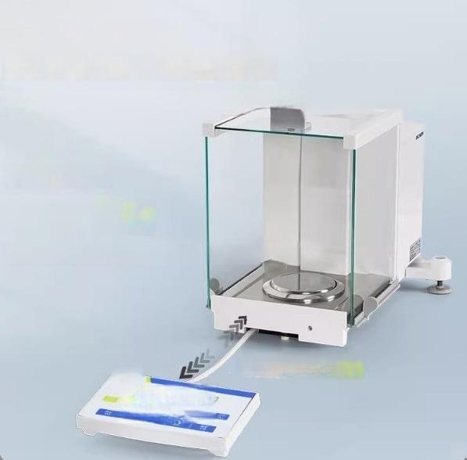
Split structure
Strong anti-interference ability and stable weighing
Eliminate the thermal impact generated during the operation process
stability time
2.5s/15s
One ten thousandth/one hundred thousandth
^{stretchable} 27cm
BICHE
口

Slide 5
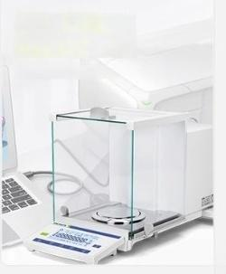
Standard USB RS232C
interface
Connect computer and printer

Slide 6
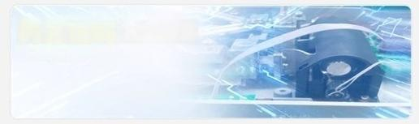
Built in weight automatic calibration
Simplify the calibration process

Slide 7
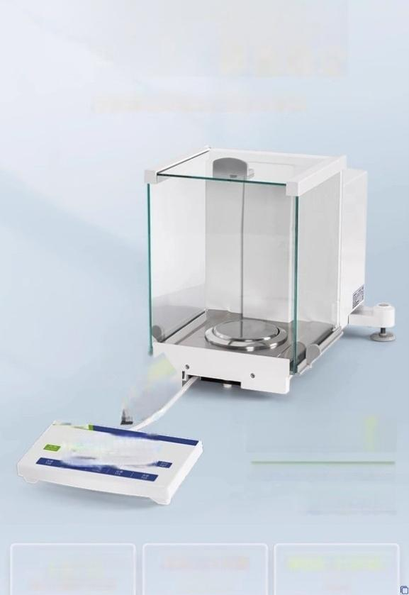

The split structure has strong anti-interference ability and stable weighing
Eliminate the thermal impact generated during the operation process
2
2.5s/15s
One ten thousandth/one hundred thousandth
stability time
Stretchable type Operation display terminal
Electromagnetic force sensor Rear design
Weighing tray and windproof ring
match

Slide 8
High precision and multifunct
ional to meet personalized
customer needs
》Dual range switchable(0.1mg/0.01mg)《
》Integral time and sensitivity adjustable《
》Counting,percentage weighing,density measurement
》Printing function,data transmission《

Slide 9
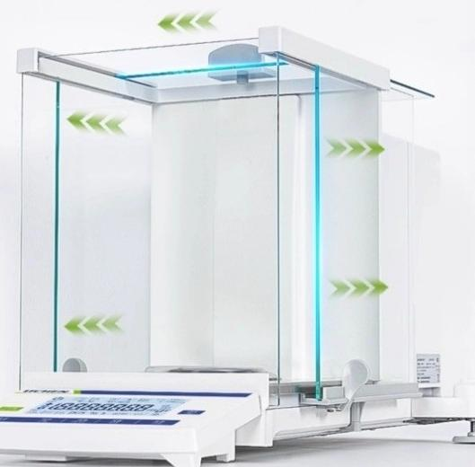
Three way opening and
closing windproof cover door sample is 100%visible
Rear design ofelectromagnetic force sensor,increasing operating space

Slide 10
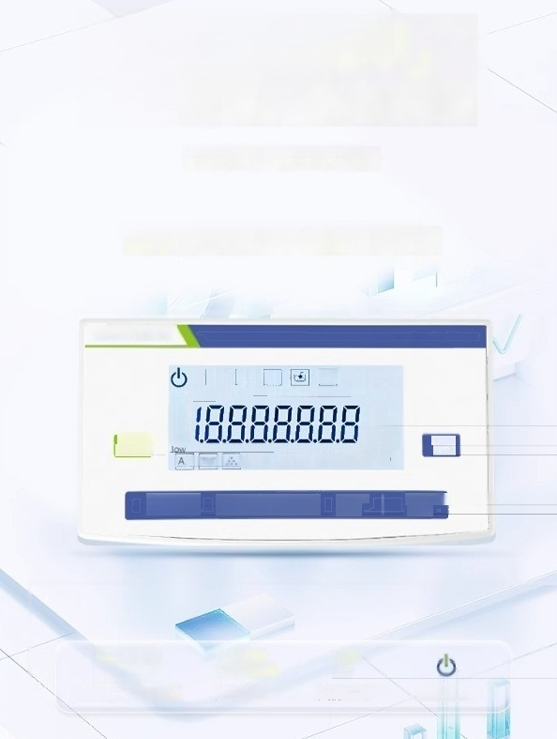
LCD display with clear
display and simple
operation
High brightness,fast response speed
8 weighing modes and 5 unit conversions
LICHEN
团 A
wt-Air
c
wt-liquid
ata
Max-888g
d=088 mg
ct
oz
hiah
On/off
ON/OFi
+One
2ePe
mgr
^{pcs} %k g/cm2 cm lb
print
PAT
calibration functior
CAL FUNC1
set up STE
remove t poel
TAR
Max88889
d=0.88
Mximu%ango
wt-Air
wt-liquid
Pensity
high
low
measuremen Hyy inspection
mg
and
standby mode

Slide 11
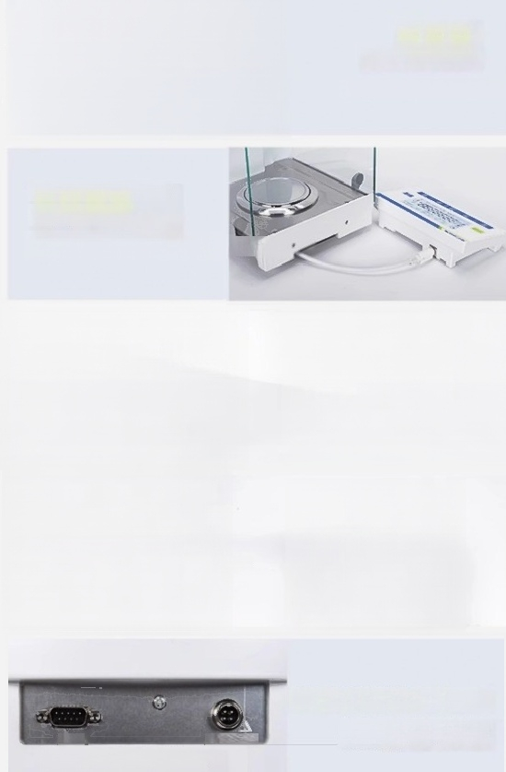
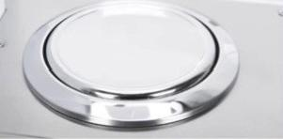
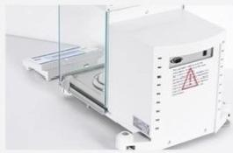
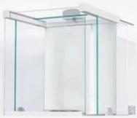
Weighing tray+
Windproof ring design
inata the interference caused t
Stretchable operation
display terminal
Redue the hermal impactgeneratedurinaption
Rear electromagnetic force sensor
Stable structure,with large
space operation for temperatur
e compensation correction
Three way opening and closing
windproof oover
Multi directional obsenvation of sample status
USB,RS232C interface
Realize communication between
2sZc Pawer Sy
This equipment complies with the
requirements in par 15of FCC rules
data and computers,printers,or
other devices

