Slide 1
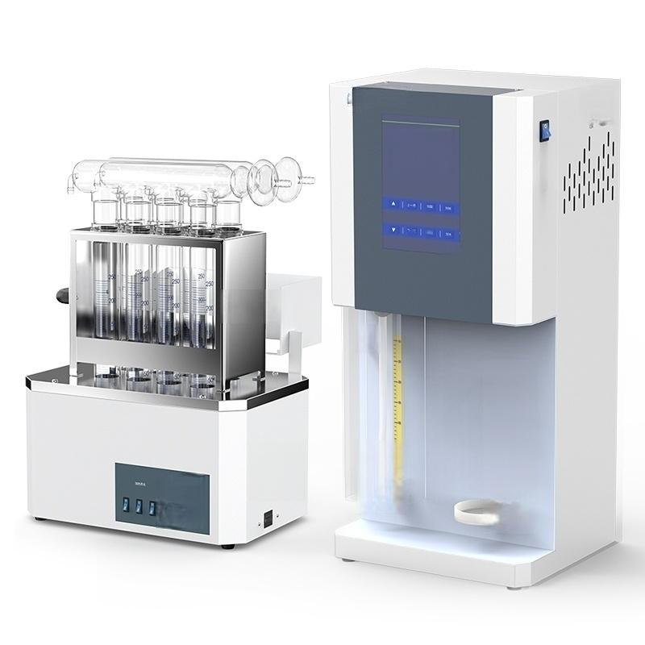


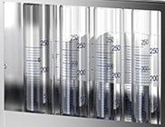





△△

Slide 2

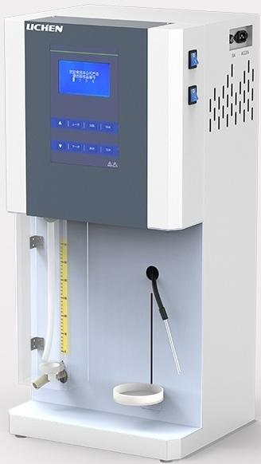
Nitrogen Determinator Distillation Device
Protein quantification equipment
LC-KDN Series )
The choice of new generation laboratories

Slide 3


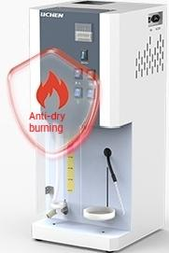
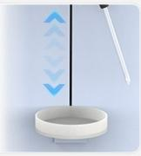
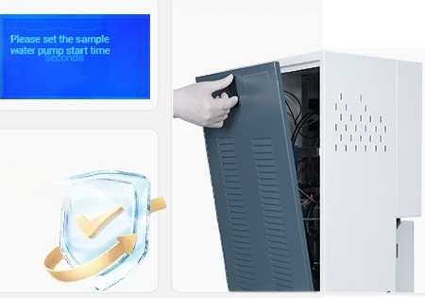
Product Features
Independent piping system
Multiple pipelines
independently controlled,
to prevent
cross-contamination
Lifting tray
According to the bottle size
Adjust tray height
The
Water level safety monitoring
water level of the evapoation furnace is autamatically contralled,and it is equipped with
anti-dry burning.
Function,no water automatic off heating
LCD LCD data display Humanized design
Data display is clear and
LC-KDN-B3)
Removable rear cover for user-friendly cleaning and maintenance
intuitive (limited to
Professional and reliable
Compliance with GB/T33862-2017
"Fully(semi)automatic Kjeldahl
nitrogen analyzer'national standard
requirements

Slide 4
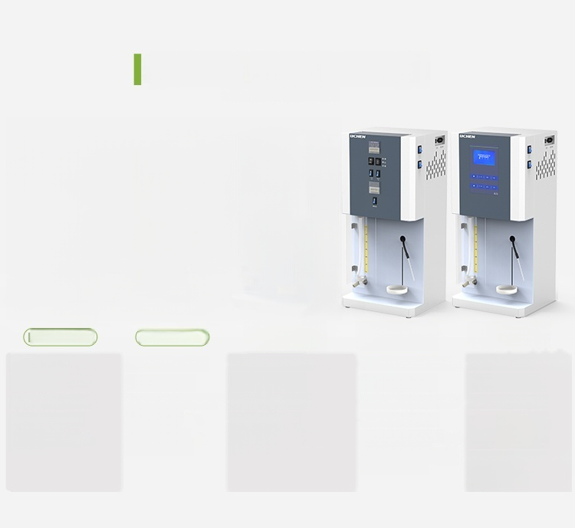
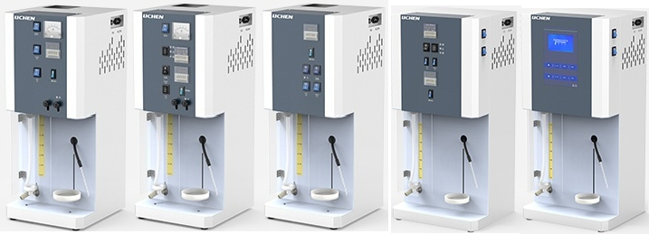
Types and differences of distillers
PARAMETER TABLE
^{C-KDN-A1} ^{LC-KDN-A2} LC-KDN-B1 LC-KDN-B LC-KDN-B3
Steam water souce tap water | Steam water sourec:tap water | mmwirsone pindw lldm | ^{Mwirone} ^{podw} _{ld} | Ba wator soae pine wor/driledwar
Timing function:yes | Timing function:yes | Timing function:yes | Timing function:yes | Timing function:yes
Contelmethod maual contol | ContolmethodmanualVautomatle con | tol ontol method marul contol | Controlmthat marul/autemale coned | Cantrolmethad automatecaniund
 | Aadomatle/anudalall
Heating method electrode heating | dalonvwater dulien Heating method: electrode heating | Mdslwaresa Heating method:Stainless steel heating tube | Aulenatbablwlehacily adlan Marualalkall adflovdald waiar dalonvypuifedwaieraduon | Automatic akal/water/acidity addifion can save 4 operation programs
 |  |  | Heating method:Stainless steel heating tube | ianlng mechot stanlesal hachg tube 4.5-inch LCD display screen

Slide 5
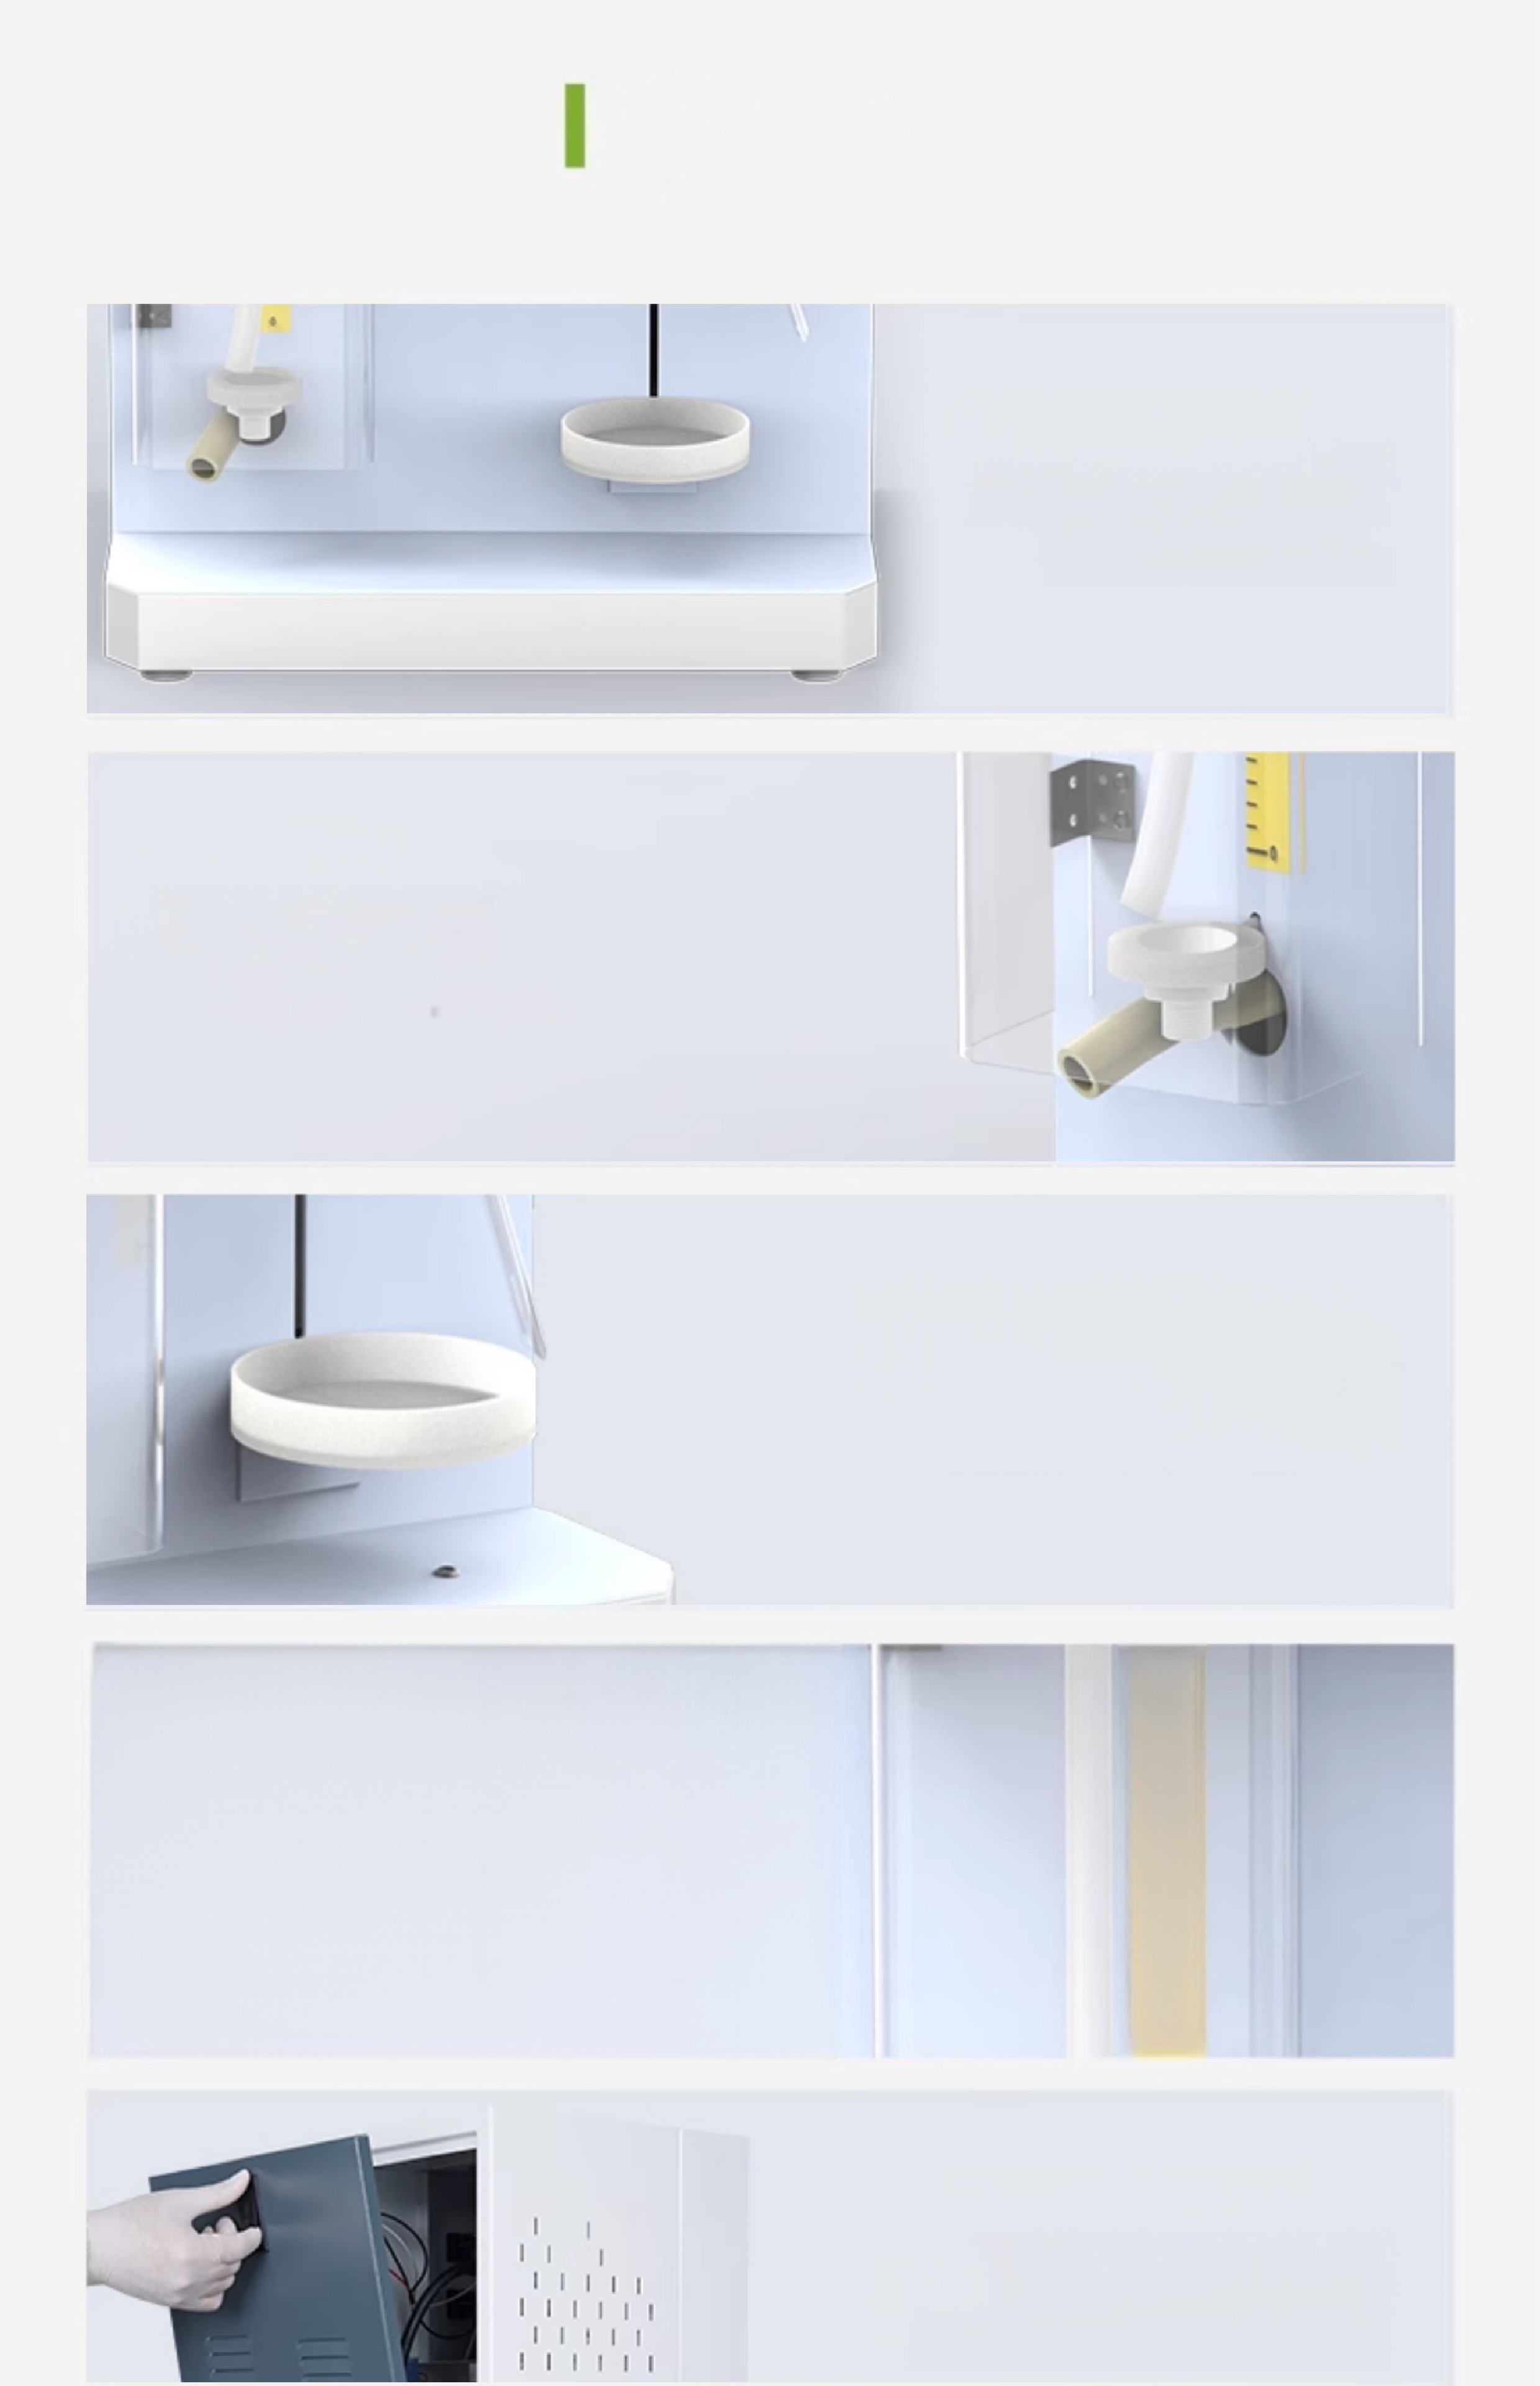

Other details
Other details
Bottom stainless steel
plate
Reinforced base,
more stable operation
Digestive tube tray
Used for placing digestion
tubes after digestion
Waste liquid collection plate
Used for placing waste liquid
collection bottles,acid and alkali
resistant
Equipped with a graduated scale ruler
Facilitates user experiment
observation and use
250
200
-150
-100
Detachable back cover
Convenient for cleaning and
maintenance,humanized design

Slide 6
packing list
Serial Number | Name | Quantity
1 | Host | 1
2 | Power Cable | 1 root
3 | 10A Fuse Tube (LC-KDN-B3) | 3
4 | 10A Fuse(LC-KDN-B¹/B2) | 2
5 | 15A Fuse (LC-KDN-A1/A2) | 6
9 | 6×11 Rubber Tubes | 1 root
7 | 13×17 Rubber Tube(LC-KDN-A1/A2) | 1 root
8 | User manual | 1 portion
9 | Certificate of Qualty/Warranty Card | 1 portion

Slide 7
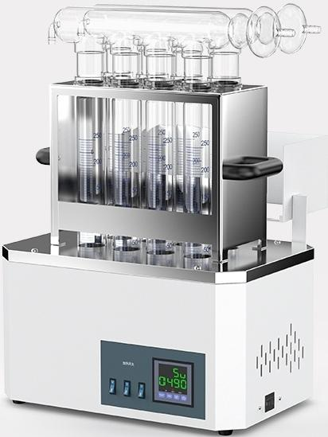
Nitrogen Determinator Digestion Furnace
Multiple samples are digested
simultaneously with rapid heating
LC-KDF Series)
The choice of new generation laboratories

Slide 8
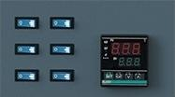
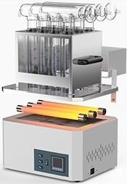
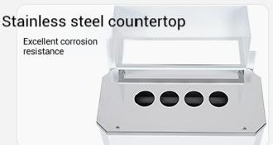
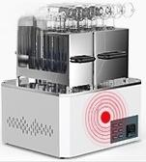
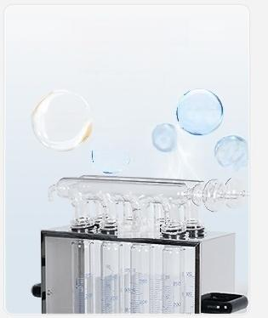


Heating element switch single control
Can control heating according to different experiments
Product Features
Multiple infrared quartz heating tubes
Efficient boiling elimination
Good heating performance,high heat conversion rate
Multiple warning functions
Over-temperature and timeout alarm
Corrosion-resistant fluorine rubber ring
Good sealing
Safer to use
Various
(Strong
Alkali Sodium
sulfate
Gas
一
Potassium sulfate
Various
Poisonous
Automatic insulation,timing
Limited to LC-KDF-04D/08D/12D)
(5YP8ng Acid

Slide 9
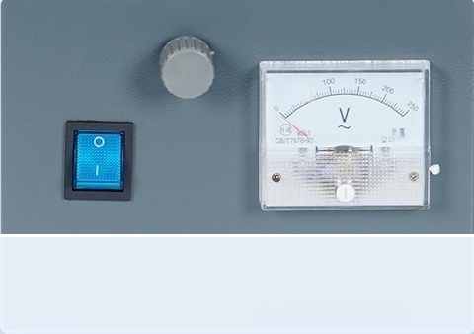



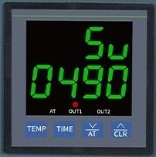

厂 I nteligent temperature
control system
Simple operation
Different models use SCR voltage regulation and temperature control
PID intelligent temperature control instrument control
明
8
LC-KDF-04/08
Temperature control method:SCR voltage regulation and temperature control
LC-KDF-04D/08D/12D/20D
Temperature control method:PID intelligent temperature control instrument control

Slide 10
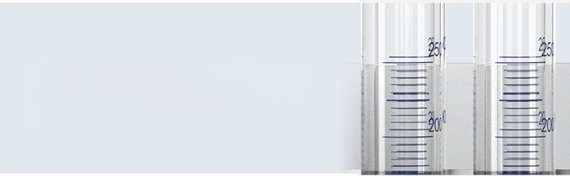
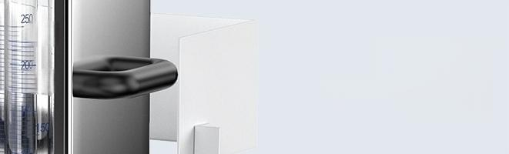
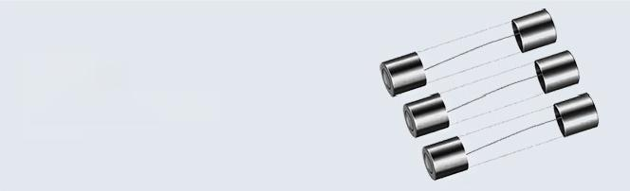

Other details
Digestive tract with built-in scale
Facilitates user reading of values,convenient
for experimental operation
250
200
Rubber wood
handle
Prevents experimenters from scalding
Fuse
Used to protect instrument
safety
IIIIl
IIIIl Rubber bottom
corner
Corrosion-resistant,anti-slip,easy to fix instruments

Slide 11
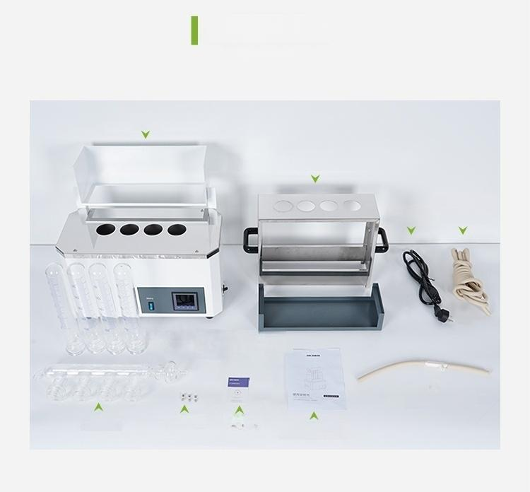
Accessories List
packing list
Host
Digestive tract mounting rack tray
PowerCable
6mm inner
diameter
Rubber hose
Digestive tube
0 ^{aling}
人
<S
e
rin
g
Air extraction tee
User manual
Collection tube
Fuse tube (Fuse)
Certifeateof
)Waranty card

Slide 12

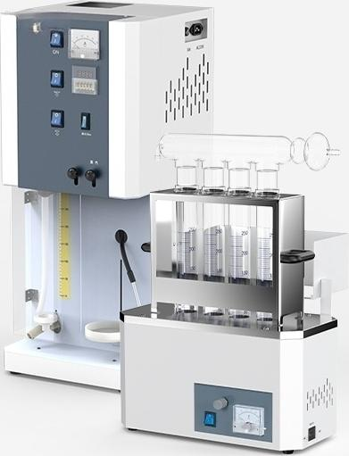
LC-KDN-A1+LC-KDF-04 Set
Nitrogen Determinator Distillation Device + Nitrogen Determinator Digestion Furnace
Nitrogen Determinator Distillation Device
Measurement Range: | 0.1-220mg | Nitrogen(0.02%-98%)
Recovery. |  | ≥99.5%
Repeataility. | Average | Relative Error ±1%
Nitrogen Determinator Digestion Furnace
Temperature control range: | RT-520℃
Temperature control mode: | Voltmeter+Knob
Standard number of digestive tracts: | 4

Slide 13

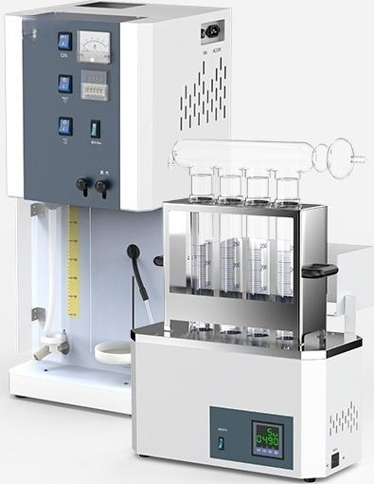
LC-KDN-A1+LC-KDF-04D Set
Nitrogen Determinator Distillation Device+ Nitrogen Determinator Digestion Furnace
Nitrogen Determinator Distiller
Measurement Range: | 0.1-220mg Nitrogen(0.02%-98%)
Recovery. | ≥99.5%
Repeataility. | Average Relative Error ±1%
Nitrogen Determinator Digestion Furnace
Temperature control range: | RT-530℃
Temperature control mode: | PID intellgent temperature control instrument
Standard number of digestive tracts: | 4

Slide 14

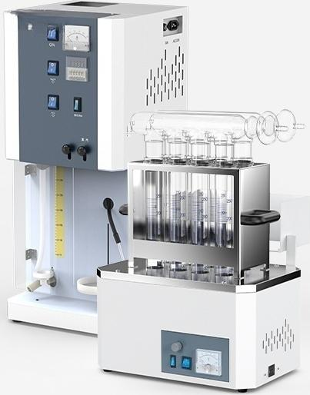
LC-KDN-A1+LC-KDF-08 Set
Nitrogen Determinator Distillation Apparatus + Nitrogen Determinator Digestion Furnace
Nitrogen Determinator Distilation Apparatus
Measurement Range: | 0.1-220mg Nitrogen(0.02%-98%)
Recovery. | ≥99.5%
Repeataility. | Average value relative error within | 1%
Nitrogen | anayzer digestion furnace
Temperature control range: | RT-520℃
Temperature control mode: | Voltmeter+Knob
Standard number of digestion tubes: | 8

Slide 15

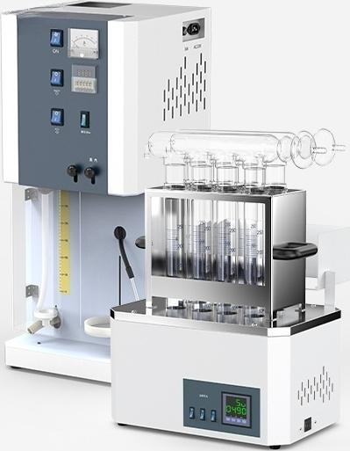
LC-KDN-A1+LC-KDF-08D Set
Nitrogen Determinator Distillation Device + Nitrogen Determinator Digestion Furnace
Nitrogen Determinator Distillation Device
Measurement Range: | 0.1-220mg | Nitrogen(0.02%-98%)
Recovery. |  | ≥99.5%
Repeataility. | Average | Relative Error ±1%
Nitrogen Determinator Digestion Furnace
Temperature control range: | RT-530℃
Temperature control mode: | PID intelligent temperature control instrument
Standard number of digestive tracts: | 8

Slide 16

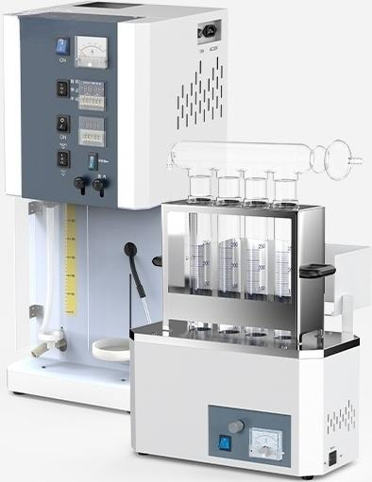
LC-KDN-A2+LC-KDF-04 Set
Nitrogen Determinator Distiller+ Nitrogen Determinator Digestion Furnace
Nitrogen Determinator Distiller
Measurement Range: | 0.1-220mg Nitrogen(0.02%-98%)
Recovery. | ≥99.5%
Repeataility. | Average value relative error±1%
Nitrogen | anayzer digestion furnace
Temperature control range: | RT-520℃
Temperature control mode: | Voltmeter+knob
Standard number of digestion tubes: | 4

Slide 17

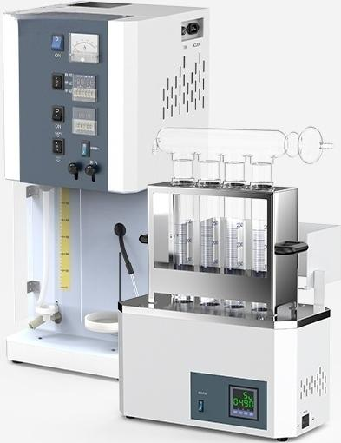
LC-KDN-A2+LC-KDF-04D Set
Nitrogen Determinator Distiller+ Nitrogen Determinator Digestion Furnace
Nitrogen Determinator Distiller
Measurement Range: | 0.1-220mg Nitrogen(0.02%-98%)
Recovery. | ≥99.5%
Repeataility. | Average value relative error±1%
Nitrogen analyzer digestion furnace
Temperature control range: | RT-530℃
Temperature control mode: | PID intelligent temperature control instrument
Standard number of digestion tubes: | 4

Slide 18

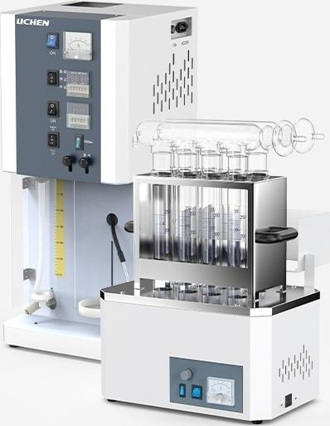
LC-KDN-A2+LC-KDF-08 Set
Nitrogen Determinator Distillation Device+ Nitrogen Determinator Digestion Furnace
Nitrogen Determinator Distillation Device
Measurement Range: | 0.1-220mg | Nitrogen(0.02%-98%)
Recovery. |  | ≥99.5%
Repeataility. | Average | Relative Error ±1%
Nitrogen | analyzer digestion furnace
Temperature control range: | RT-520℃
Temperature control mode: | Voltmeter+knob
Standard number of digestion tubes: | 8

Slide 19

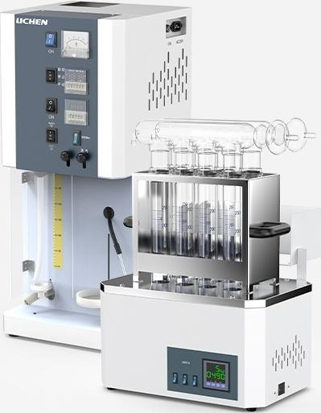
LC-KDN-A2+LC-KDF-08D Set
Nitrogen Determinator Distillation Apparatus + Nitrogen Determinator Digestion Furnace
Nitrogen Determinator Distilation Apparatus
Measurement Range: | 0.1-220mg | Nitrogen(0.02%-98%)
Recovery. |  | ≥99.5%
Repeataility. | Average | value relative error within | 1%
Nitrogen analyzer digestion furnace
Temperature _{RT-530℃}
control range:
Temperature PID intelligent temperature
control mode: control instrument
Standard number of
8
digestion tubes:

Slide 20

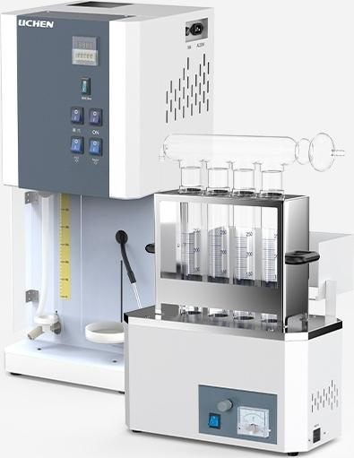
LICHEN LICHEN
LC-KDN-B1+LC-KDF-04 Set
Nitrogen Determinator Distillation Device+ Nitrogen Determinator Digestion Furnace
Nitrogen Determinator Distillation Device
Measurement Range: | 0.1-220mg | Nitrogen(0.02%-98%)
Recovery: |  | ≥99.5%
Repeatability: | Average | Relative Error±1%
Nitrogen Determinator Digestion Furnace
Temperature controlrange: | RT-520℃
Temperature controlmode: | Voltmeter+Knob
Standard number of digestive tracts: | 4

Slide 21

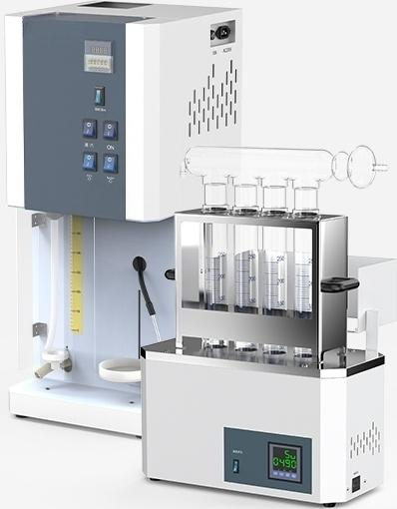
LC-KDN-B1+LC-KDF-04D Set
Nitrogen Determinator Distillation Device+ Nitrogen Determinator Digestion Furnace
Nitrogen Determinator Distillation Device
Measurement Range: | 0.1-220mg | Nitrogen(0.02%-98%)
Recovery. |  | ≥99.5%
Repeataility. | Average | Relative Error±1%
Nitrogen Determinator Digestion Furnace
Temperature control range: | RT-530℃
Temperature control mode: | PID intelligent temperature control instrument
Standard number of digestive tracts: | 4

