Slide 1

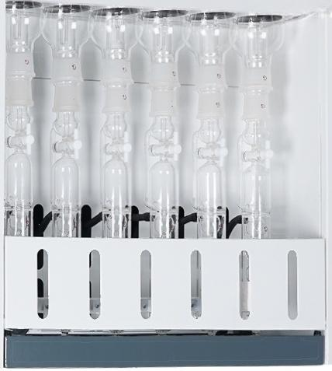
9
9

Slide 2
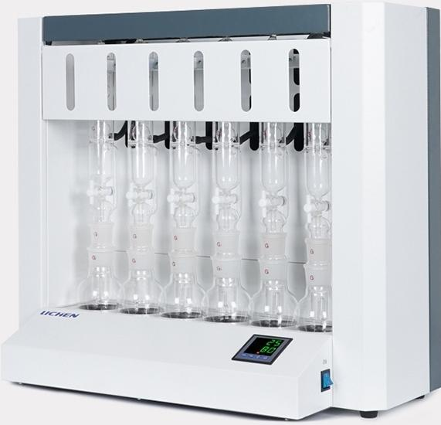
Crude Fat Tester
Soxhlet extractor for fat content determination
SZF Series
Selection of a new generation of laboratories
The choice of new generation laboratories

Slide 3
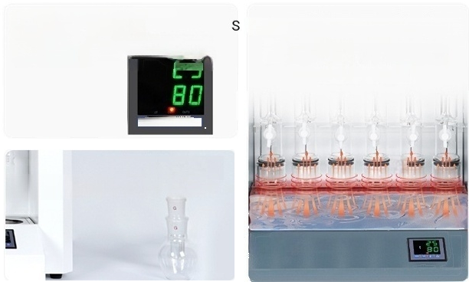
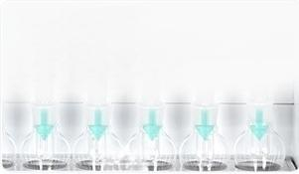
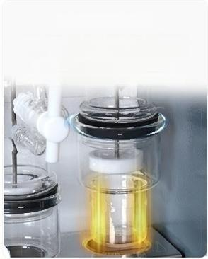
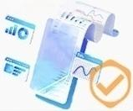
Product Features
Digital display automatic temperature
control
Can adjust the heating temperature according to
reagent boilingpoint and ambientonerature
Achieve precise weighing
Tme |nut|首 1
Humanized design
Reagent containers can be placed on the table for easy
liquid addition
Six samples heated simultaneously
Uniform heating and rapid temperature
rise
Universal for all solvents
Made of all-glass and PTFE materials as experimental channels,resistant to
various organic reagents
Embedded heating
Good sealing to prevent leakage
Has good sealing performance
Can prevent petroleum ether leakage issues
Data results are professional and reliable
Complies with nationa standard GB5512-85
specifications

Slide 4
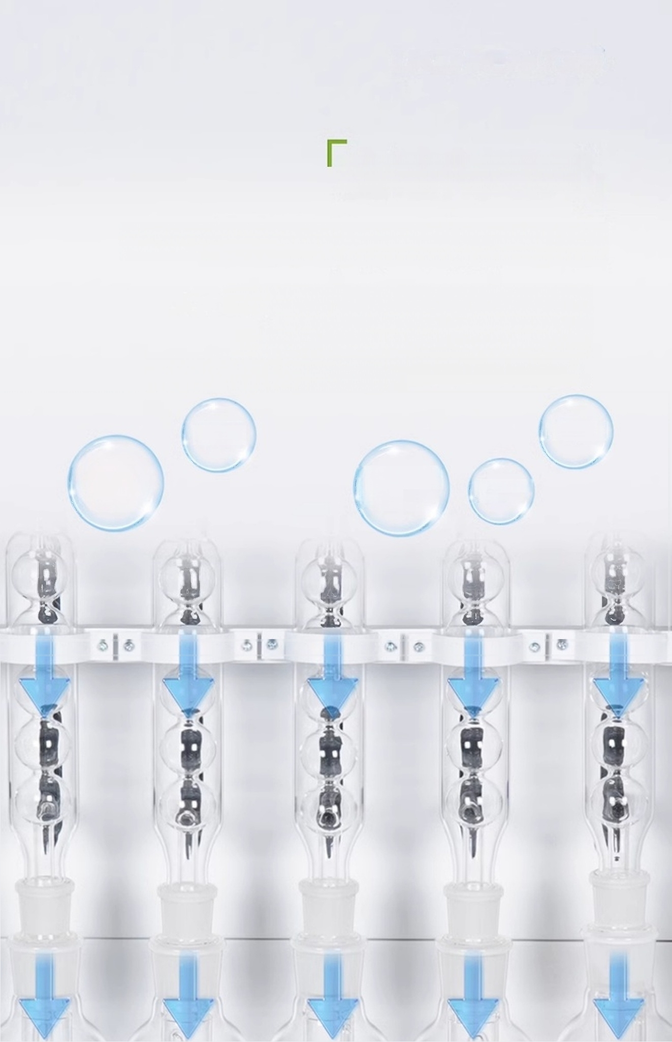
Universal solvent
Data results are professional and reliable
Made of all-glass and PTFE materials as experimental channels,capable of
withstanding various organic reagents,
The determination results meet all the indicators of
national standard GB5512-85. ^{O}
Acetone
Methanol
Petroleum
ether
Hydrochloric
acid

Slide 5
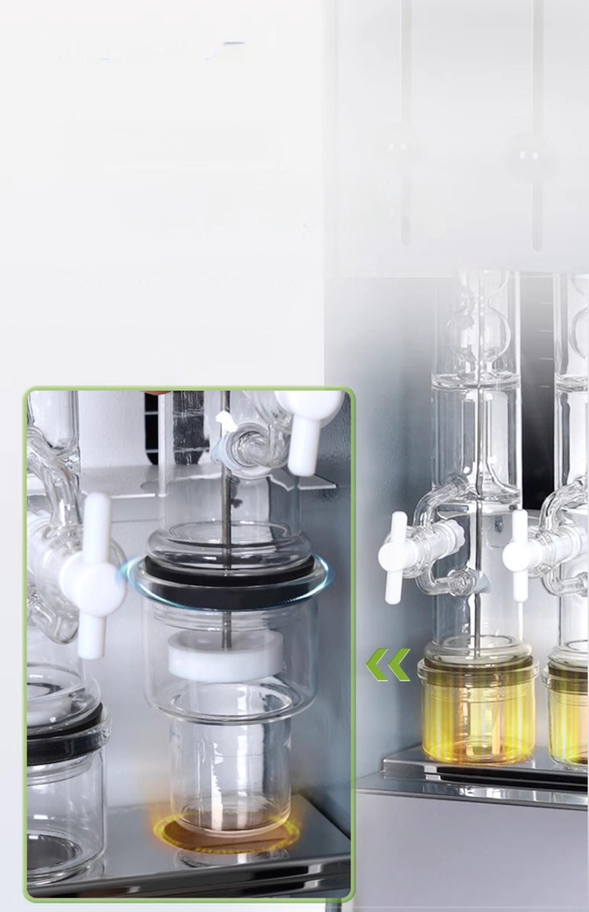
Embedded heating
Good sealing to prevent
leakage
Has good sealing performance to prevent petroleum ether leakage

Slide 6
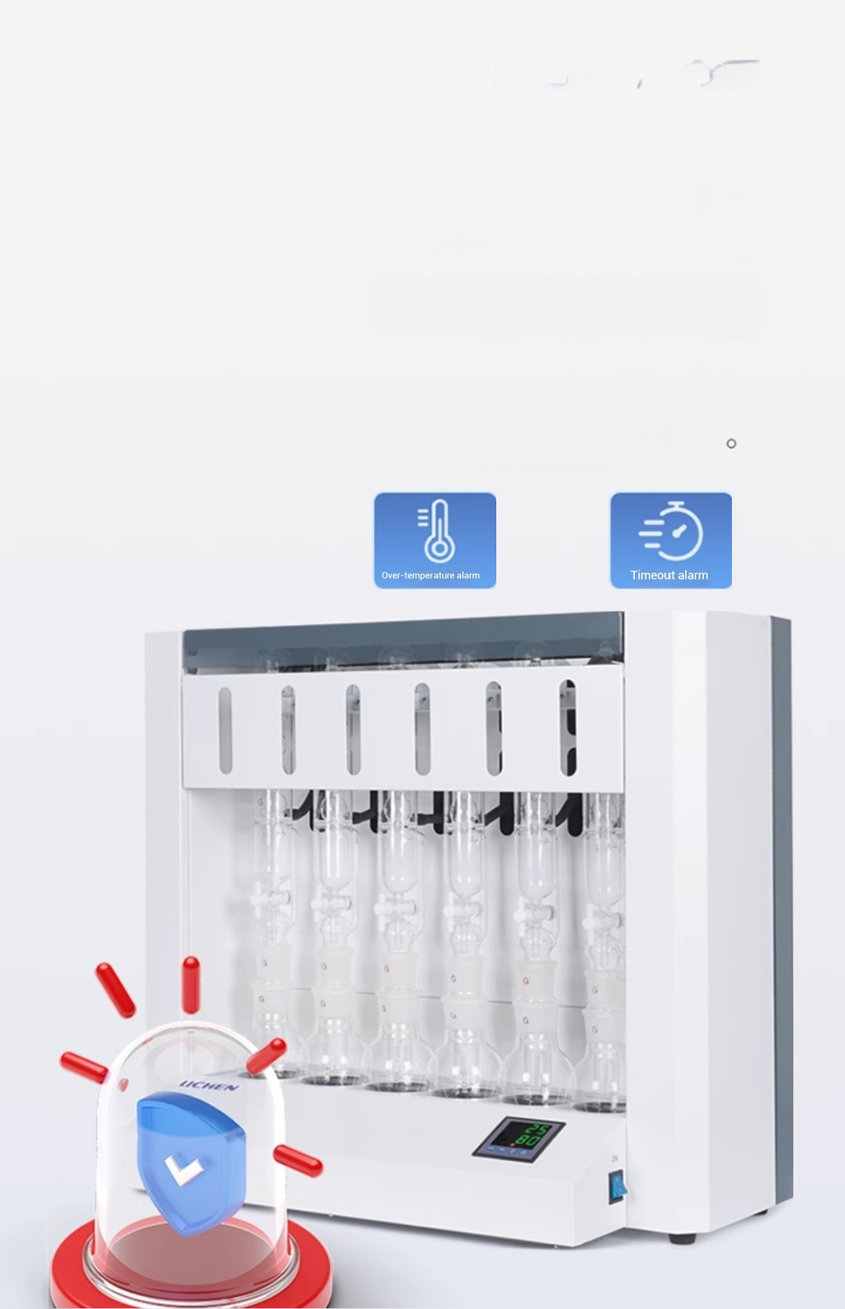
「over-temperature and
timeout alarm
Ensure experimental safety
Designed with complete isolation of circuits and extraction space; Built-in multiple warning functions,such as
over-temperature and timeout alarms.

Slide 7
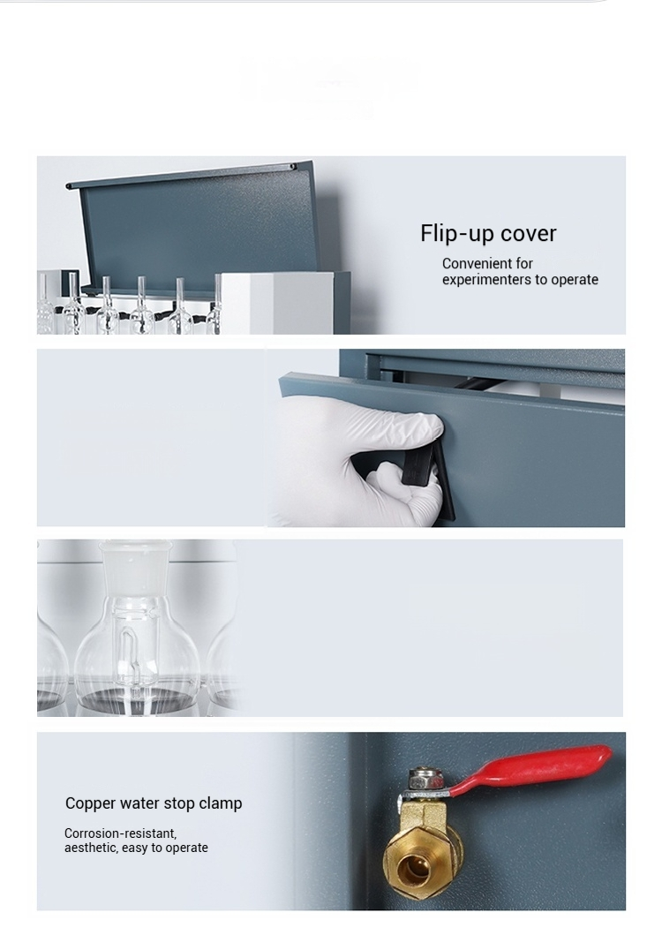
Other details
Detachable back cover
Easy for users to
inspect and repair
High borosilicate extraction bottle
High temperature resistant
and corrosion resistant

Slide 8
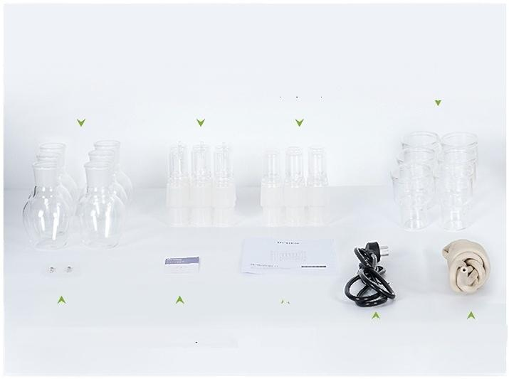
packing
list
Extraction Bottle*6 Extraction Device*6 Recycling Bottle*6 Extraction Bottle*6
(06A/06B) (06C/06D are mainframe extraction (Only 06B) ^{(06C/06D} ^{note:06D} ^{is} ^{an} ^{aluminum} ^{cup)}
5A Fuse Tube*2 Certificate/Warranty Card _{User} _{Manual} Power Cord 10A 6mm Inner Diameter Rubber Tube
baskets)

Slide 9


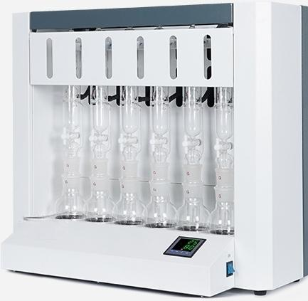
LC-SZF-06A
Crude Fat Tester
Sample weight:0.5-15g(constant 2-5g)
Number of 6 per batch tests:
^{Heating} Water bath heating Method:
Display mode: LED digital tube
Temperature Room temperature ^{control} ^{range:} -100℃
Temperature _{±1℃}
^{Solvent} ^{recovery} ≥80% rate:
control accuracy.

Slide 10


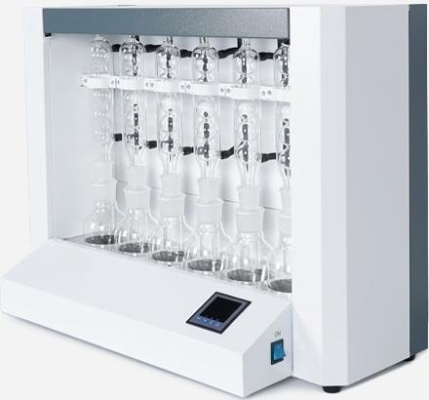
LC-SZF-06B
Crude Fat Tester
Sample weight:0.5-15g(constant 2-5g)
Number of 6 per batch tests:
^{Heating} Water bath heating Method:
Display mode: LED digital tube
Temperature Room temperature ^{control} ^{range:} -100℃
Temperature _{±1℃}
^{Solvent} ^{recovery} ≥80% rate:
control accuracy.

Slide 11


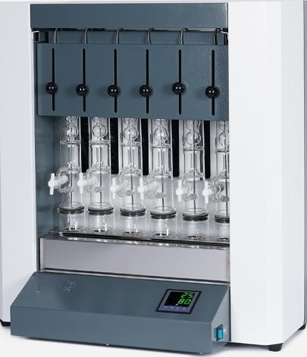
LC-SZF-06C
Crude Fat Tester
Sample weight:0.5-15g(constant 2-5g)
Number of 6 per batch tests:
^{Heating} Water bath heating Method:
Display mode: LED digital tube
Temperature Room temperature ^{control} ^{range:} -100℃
Temperature _{±1℃}
^{Solvent} ^{recovery} ≥80% rate:
control accuracy.

Slide 12


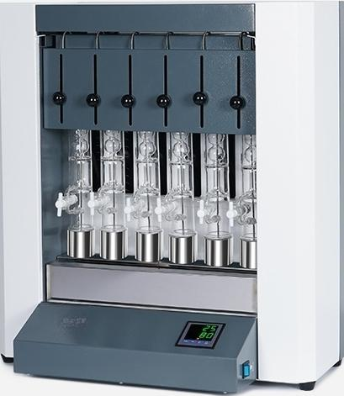
LC-SZF-06D
Crude Fat Analyzer
Sample weight:0.5-15g(constant 2-5g)
Number of 6 per batch tests:
Heating Electric hot plate Method: heating
Display mode: LED digital tube
Temperature Room temperature+5℃- ^{control} ^{range:} 300℃
Temperature _{±1℃}
^{Solvent} ^{recovery} ≥80% rate:
control accuracy.

