Slide 1
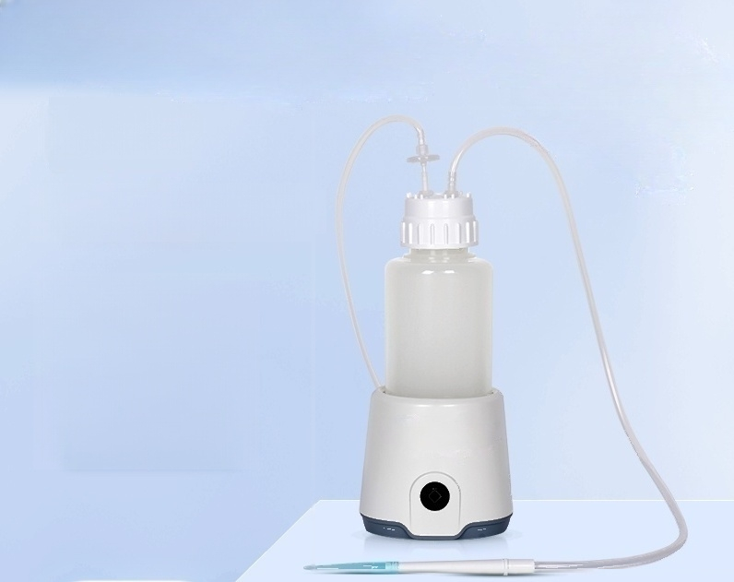
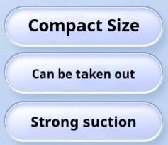
Vacuum
Suction device

Slide 2
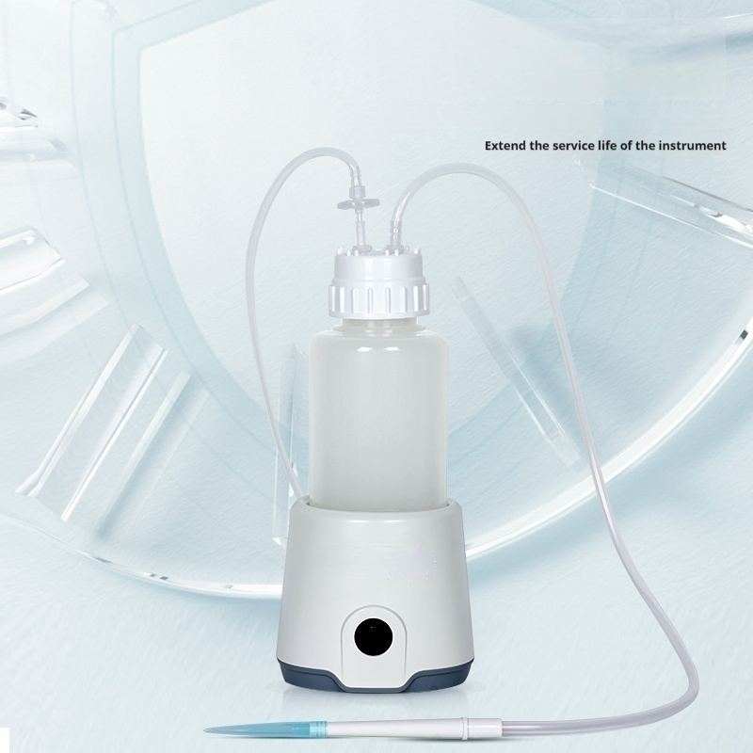
High safety
Safety protection,air filter can protect the vacuum pump

Slide 3

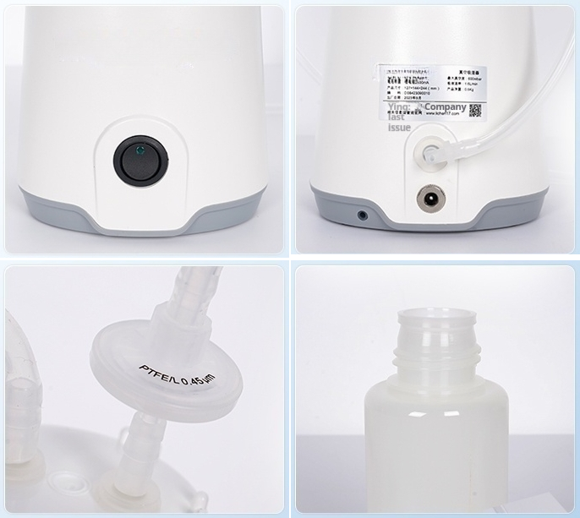
Instrument real shot display
Multi-angle detail display

Slide 4
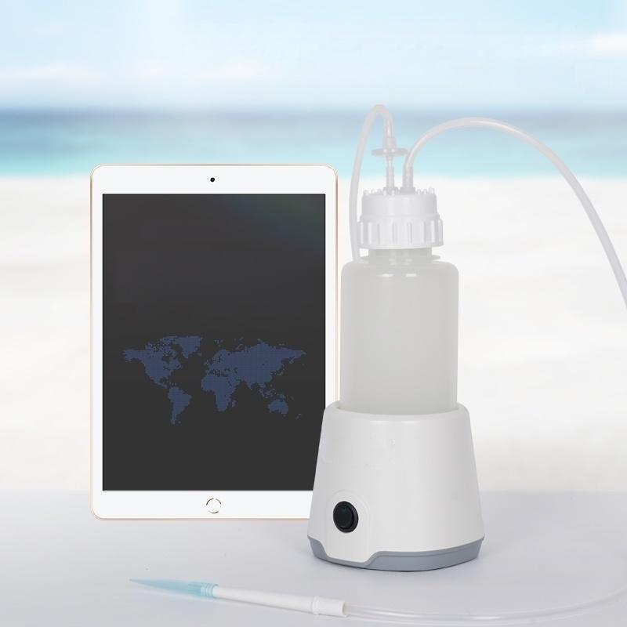
Compact in size,portable for outings
Save space by integrating a vacuum pump,liquid reservoir,and filter into one unit.
Continuous working time
050000
hour minute second
」

Slide 5
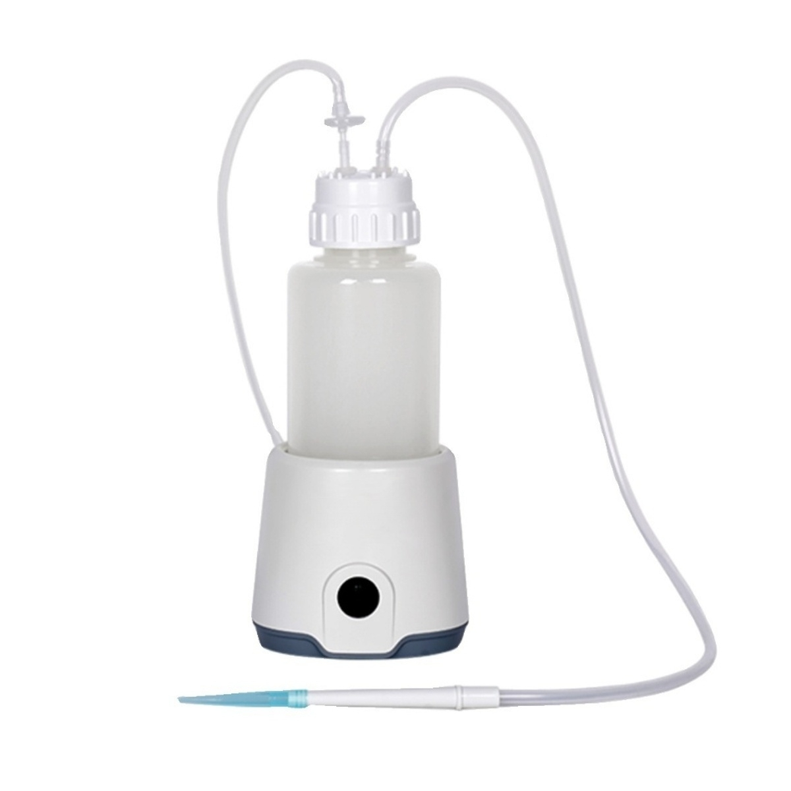

Slide 6
1 Product parameter details
Product parameters
Model | LC-VAC-1L
Power supply provided | DC 12V,1.0A
Battery Capacity | Lithium battery 2500mA
Type of motor | Brushless Motor
Maximum vacuum degree | 600mbar
Liquid absorption rate | 1.6L/min
Liquid storage bottle capacity | Standard 1L,optional 500mL filtration bottle
Liquid absorption adapter | Standard single-channel ejector(fits 1ml pipette tip),optional eight-needle needle assembly
Noise | 53dB
Product Size mm (L×W×H) | 127×144×244mm
Net weight KG | 0.5kg

Slide 7
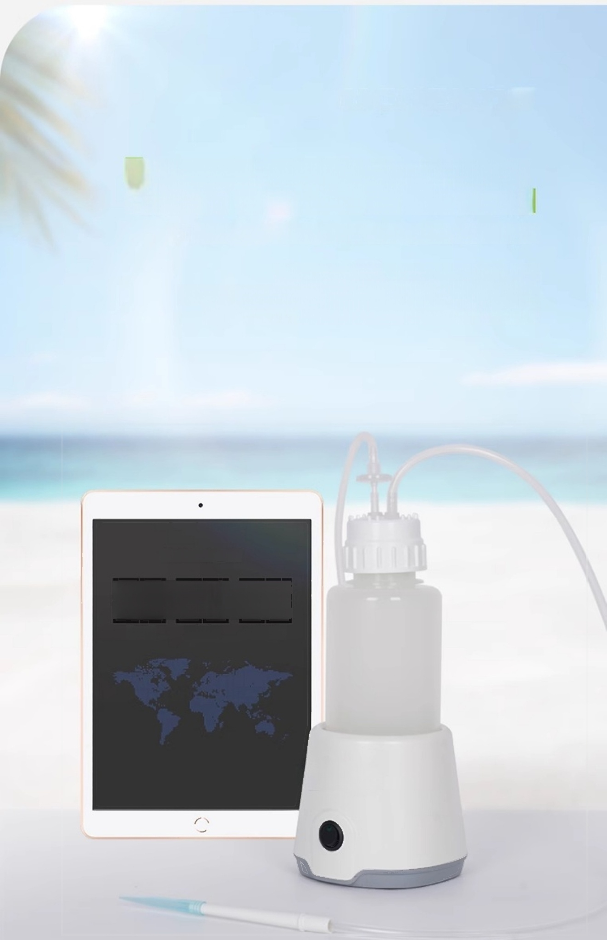
Compact Size Can be taken out
Save space by integrating a vacuum pump,liquid reservoir,and filter into one unit.
Lightweight and portable,with a rechargeable battery
It can work continuously for 5 hours after being fully
charged,making it convenient for outdoor tasks.
Continuous working time
05:0000
hour minute second

Slide 8
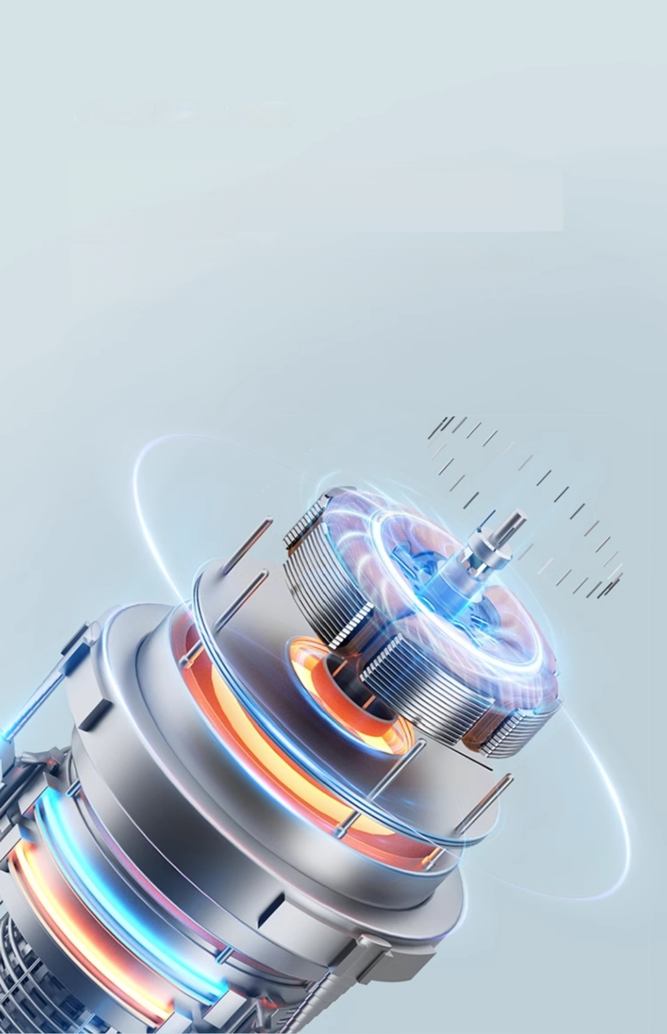
IStrong suction power,dual
functions
High-efficiency motor,strong suction power,ultra-quiet
operation,fast liquid and air absorption rates.Dual functions,
capable of both liquid absorption and filtration.

Slide 9
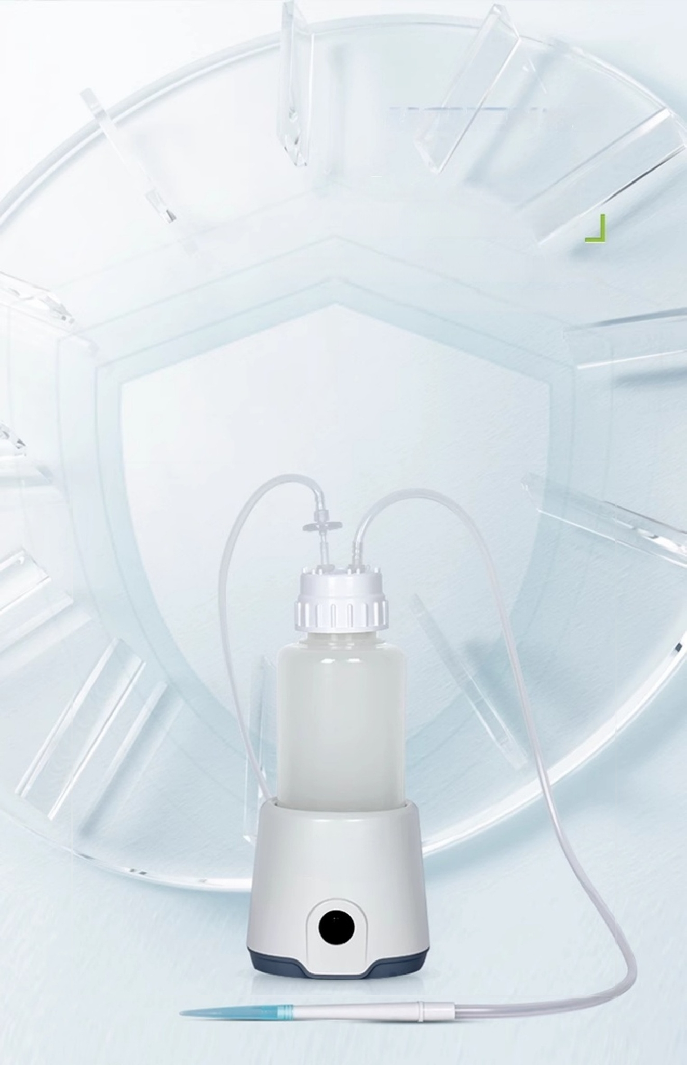
High security
Safety protection,air filter can protect the vacuum pump
Extend the service life of the instrument

Slide 10
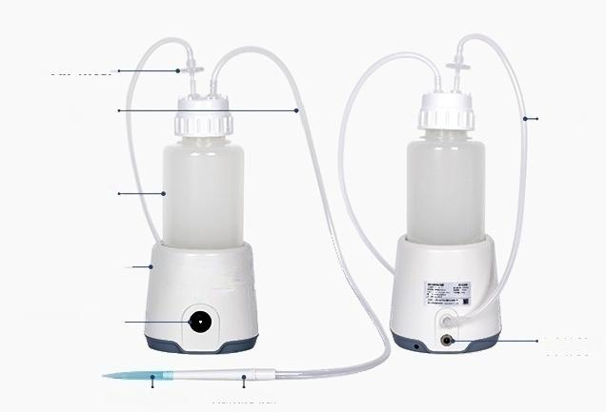
Product Analysis
Product analysis
Air filter
Suction
Tube
Liquid
Storage
Bottle
Host —
Switch_
(Indicator Light)
Suction Head Handle bar
Vacuum Tube
Power outlet

Slide 11
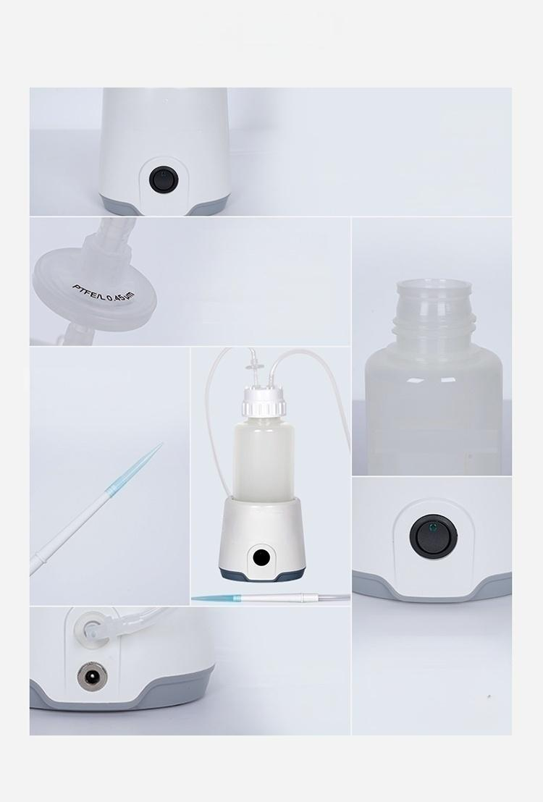
I Other Details
Other details
Host
A vacuum pump
Used to extract air from theliquid storage bottle Create a negative
Air filter
Used to filter air
If the waste liquid is a volatile hazardous
Can play a protective role
for the main unit
Suction Head
Contact waste liquid to
Used for storing waste liquid
Switch(indicator light)
pressure environment
waste liquid
absorb wasteliquid ^{Liquid} ^{Storage} ^{Bottle}
For connecting power supply
Power outlet
Control instrument
operation and stop
Device is already in
vacuum state,instrument
begins liquid absorption
indicator light on

Slide 12
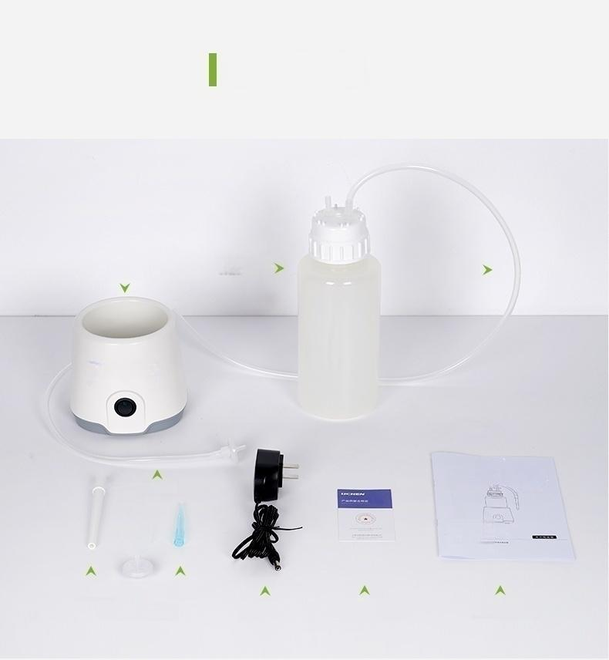
Packing List
packing list
Liquid Storage
Bottle
Adapter ^{Certificate,}
warranty card
Host
Vacuum Tube
Handle bar 人Suction Head
Air Filter x2
Suction
Tube
Use Set
Ming 4
User manual

Slide 13
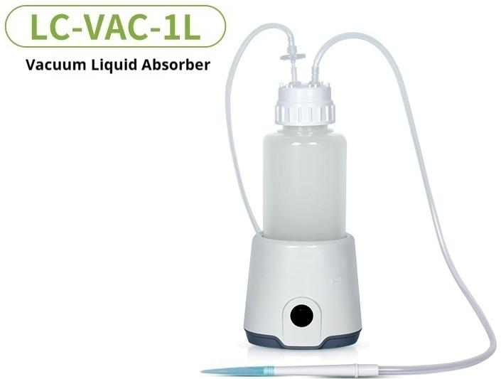
Power Supply: DC12V,1.0A | t ^{id} ^{Absorption} 1.6L/min
Battery Lithium Battery 2500mA Capacity: | Noise: 53dB
^{Motor} ^{type:} Brushless Motor | Product Size mm: 127*144*244mm
^{m} _{Degree:} 600mbar | Net Weight Kg: | 0.5Kg
L
i
qu
R
a
e:
Max
u
Vac
m

